Slide 1
Welcome
INAB Assessor Forum – 23rd January 2018
Bedford Hall Suite - Dublin Castle
Wifi
Network: Conference
Password: January-2018

Slide 2
Agenda
Welcome and Introduction
CRM – New IT system
Breakout groups
After Lunch
What's new in INAB?
Policy on Non Conformity Management / Forms
Quality
Data Protection – obligations of assessors
Q&A
12.45 - Lunch
15:15 - Tea & Coffee
16:15 – Close of forum

Slide 3
INAB Customer Relationship Management System (CRM)
Orla Ivers / Padraig Keane

Slide 4
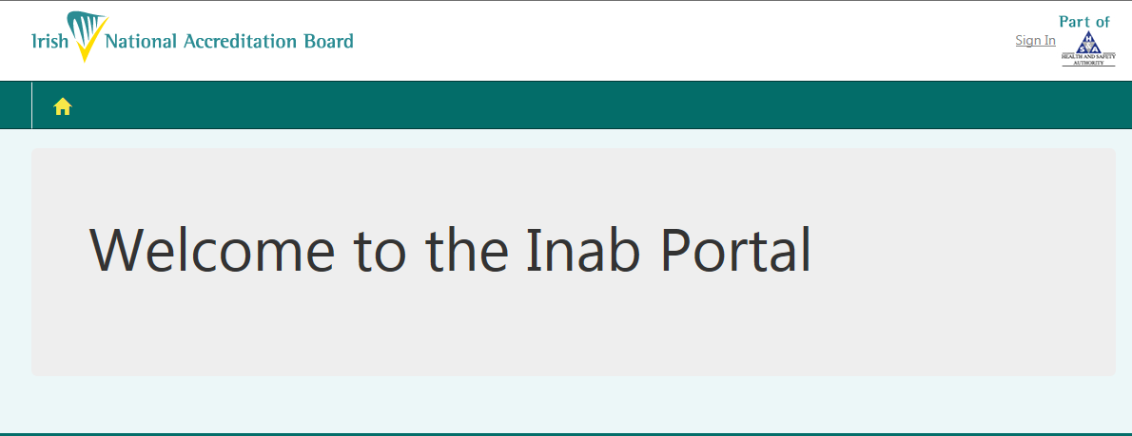
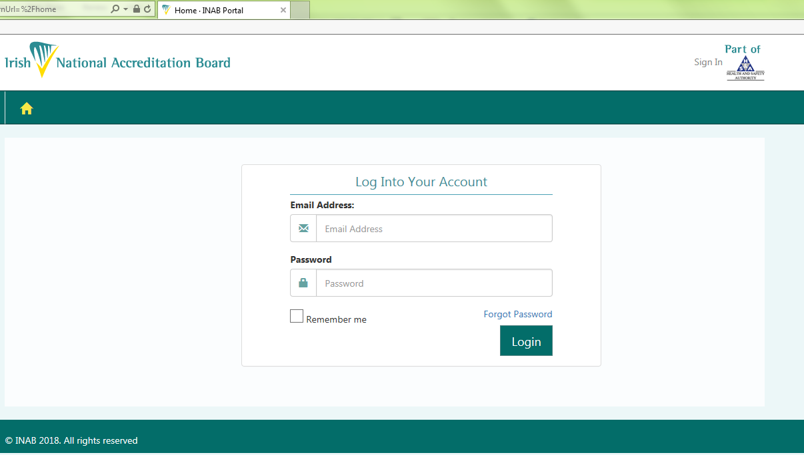
Notes:
Note the majority of attendees have used the CRM.
Purpose of today – is to provide overview, and highlight pinch points – NC Template – i.e one shot only.

Slide 5
What can you expect?
Overview of the Assessor Portal
  Access
  Events
  Claiming Fees and Expenses
Improvements and Feedback to date

Slide 6
What is the INAB CRM?
This new system was designed and developed to manage INAB data and processes associated with the accreditation and management of our Conformity Assessment Bodies (CABs).
The scope of the system included our CABs, and assessors who provide the expertise on which accreditation depends.
CRM
INAB Staff
CAB Portal
Assessor Portal

Slide 7
Background
INAB CRM launched in January 2017
Currently 84 assessors have used the CRM to manage their part in accreditation process
277 events organised in 2017
Assessors were invited to register in CRM, when their expertise required on event.

Slide 8
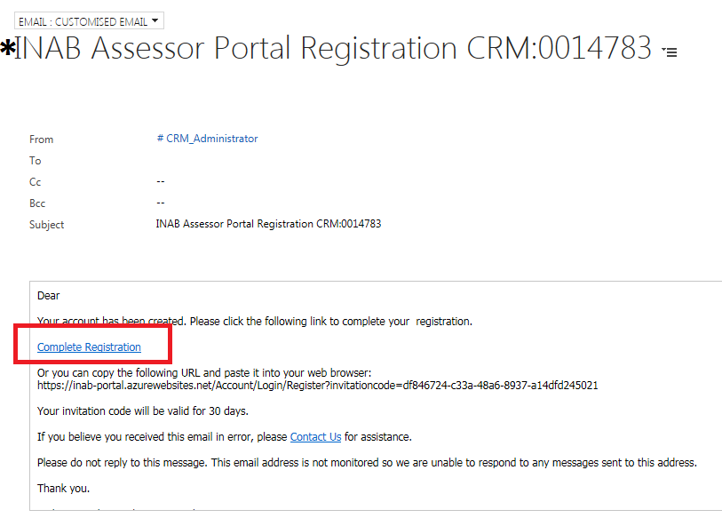
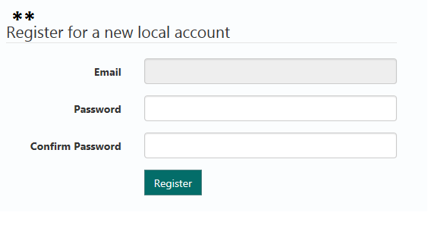
ACCESS: How to register for CRM?
Email sent
*Click on Complete Registration
**Register for new account
NB – invitation only valid 30 days

Slide 9
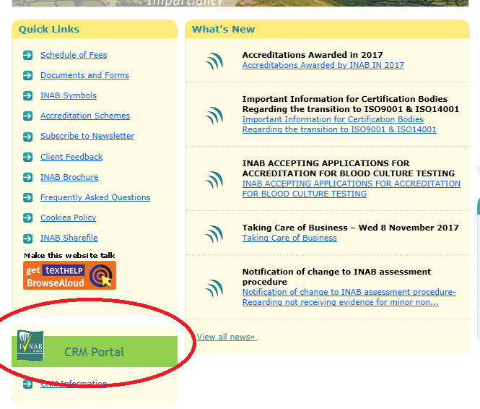
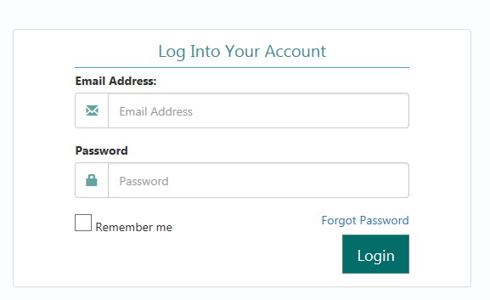
ACCESS: How to log in
Once registered
Access via INAB website – CRM portal
Enter your email and password
NB: do not use old URL invitation link once registered
INAB Website - Homepage
[Image from - Assessor Portal]

Slide 10
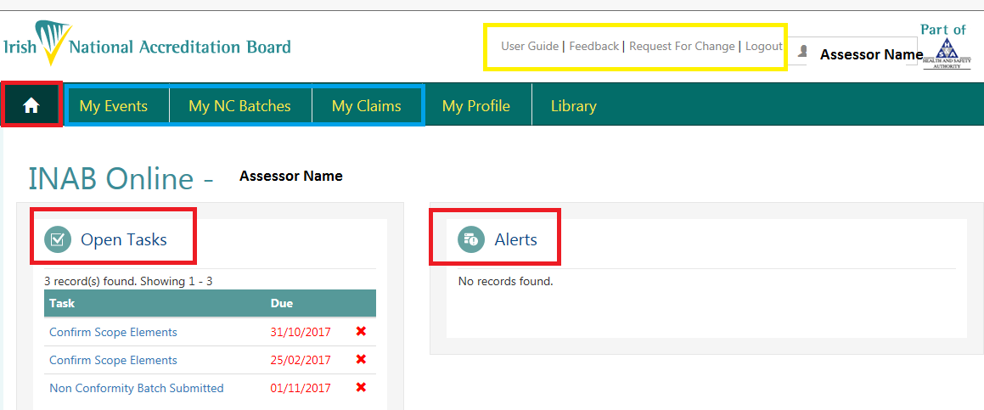
Homepage – Assessor Portal

Slide 11
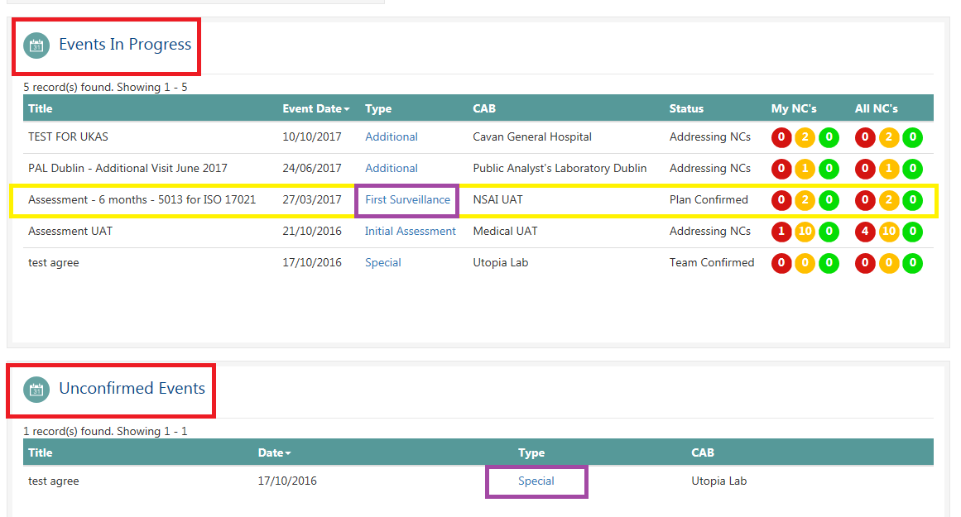
Homepage – Assessor Portal

Slide 12
Padraig Keane
Events
How to claim?

Slide 13
The Assessment Visit
Confirm availability
The visit plan
Plan confirmed
On the day
Submitting expense claims
NC review and clearances

Slide 14
Confirm availability
Review scope elements
Select for visit
Logistics and accommodation

Slide 15
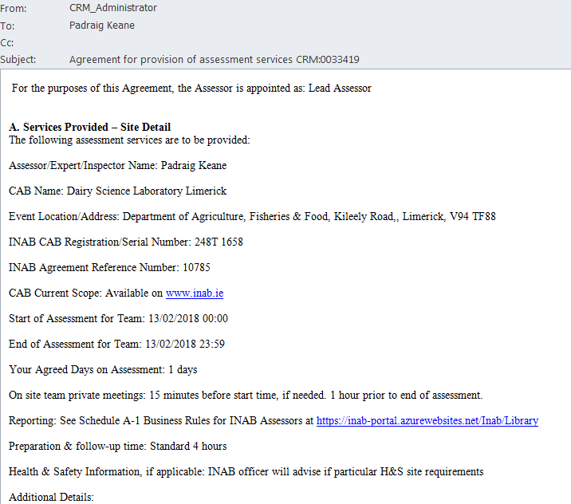
Confirm availability

Slide 16
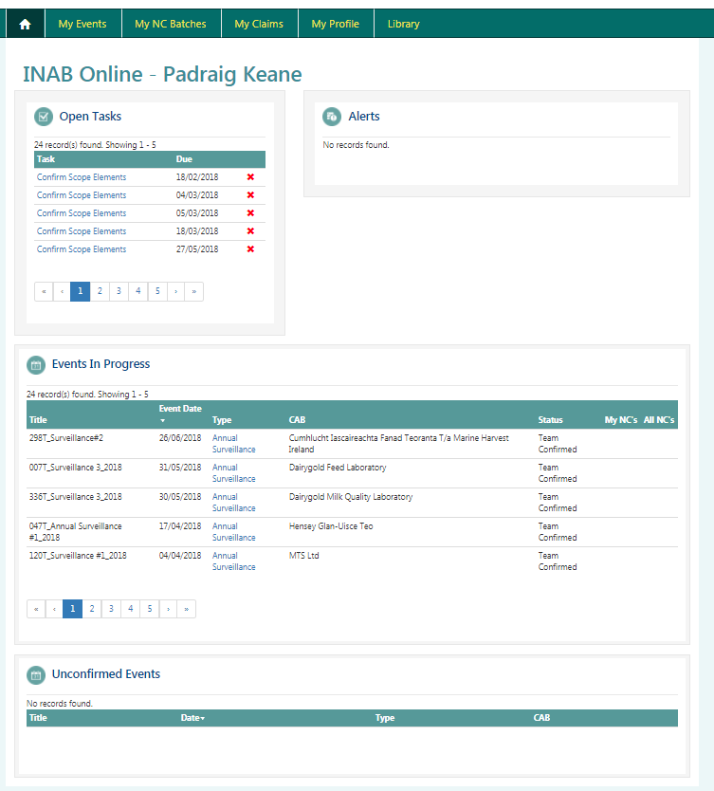

Slide 17
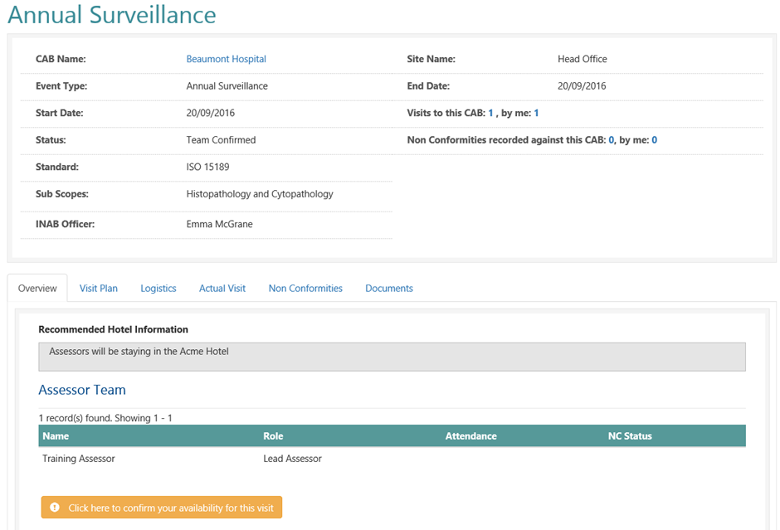
Confirm availability

Slide 18
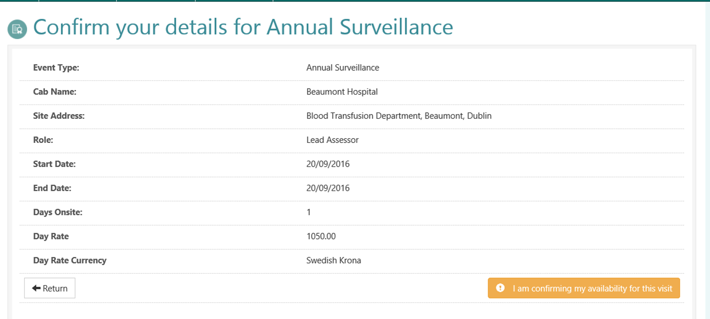
Confirm availability

Slide 19
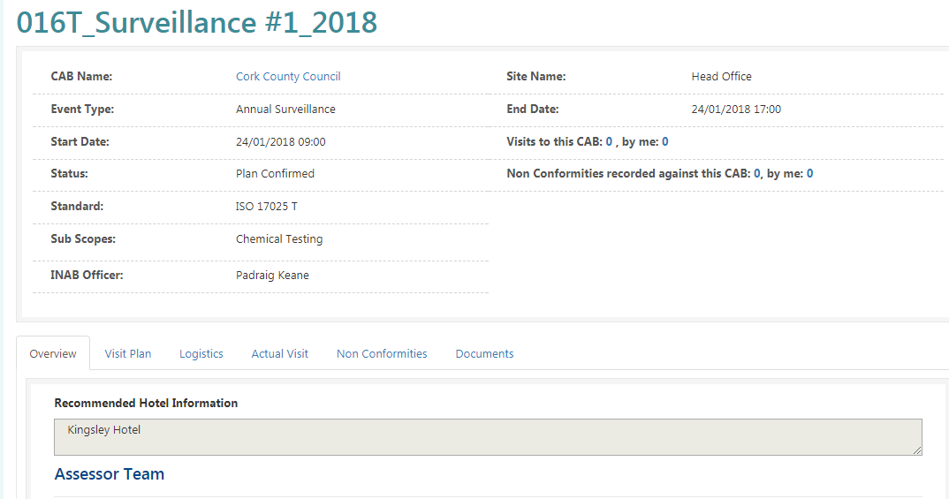
Confirm availability
Availability confirmed

Slide 20
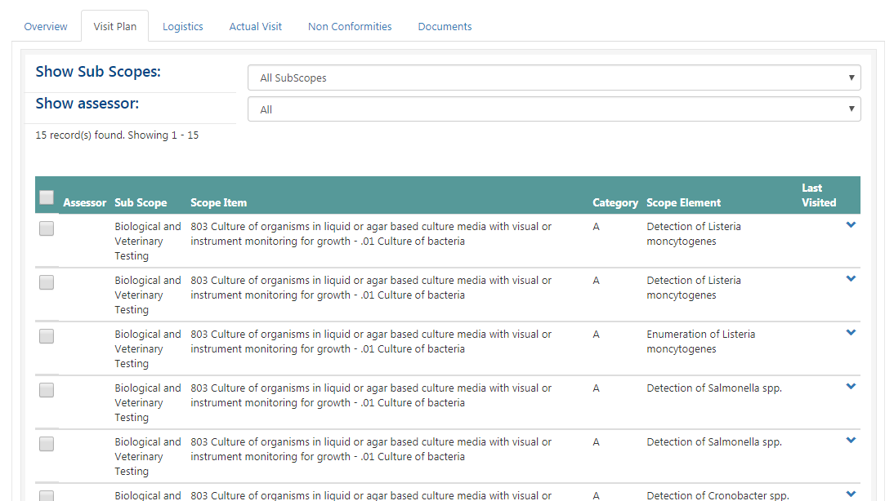
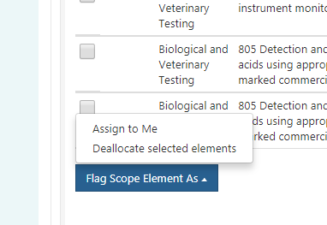
The visit plan

Slide 21
The visit plan

Slide 22
Plan confirmed
View documents
Download NC template

Slide 23
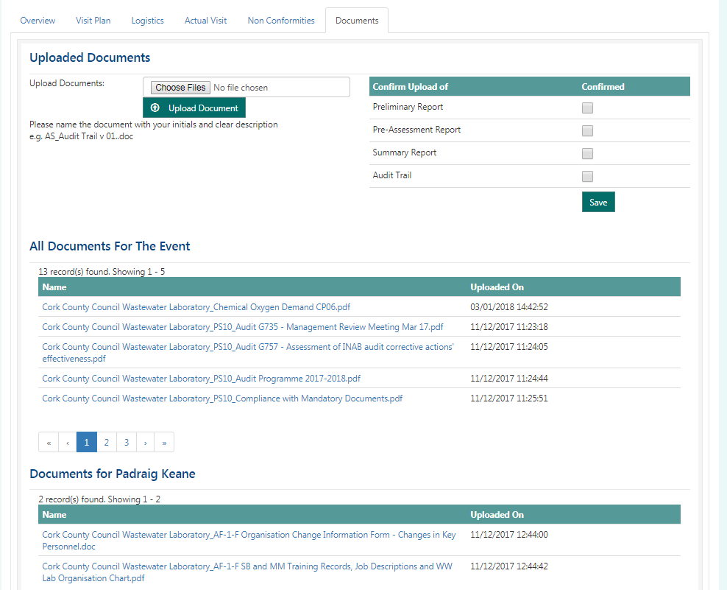
Plan confirmed

Slide 24
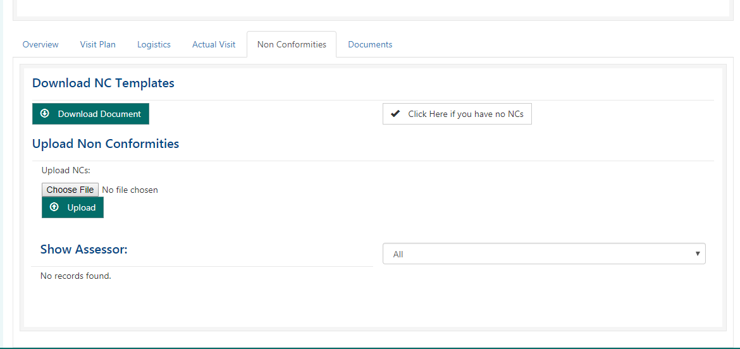
Plan confirmed

Slide 25
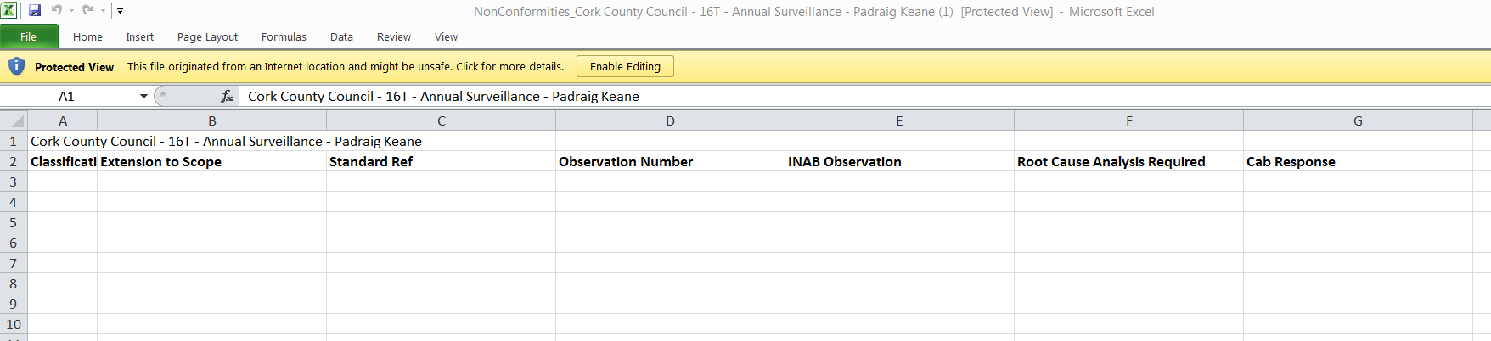
Plan confirmed
NC Template
  Unique to visit event and assessor

Slide 26
On the day
Upload NC template
  I have no NCs
  Evidence required??
  Possible errors
  Also applies to Extension to Scope by correspondence
Confirm which scope elements were witnessed
Upload report to documents section of CRM
  Officer will review before releasing to CAB

Slide 27
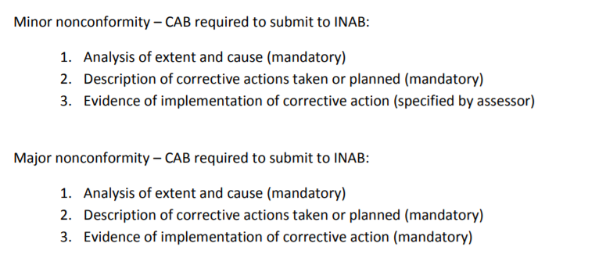
On the day
Change to assessment procedures (2017)

Slide 28
On the day
NC template upload

Slide 29

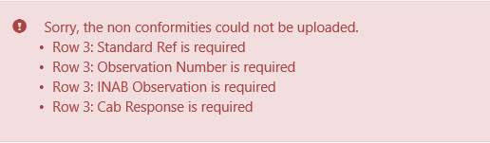

On the day
NC template errors

Slide 30
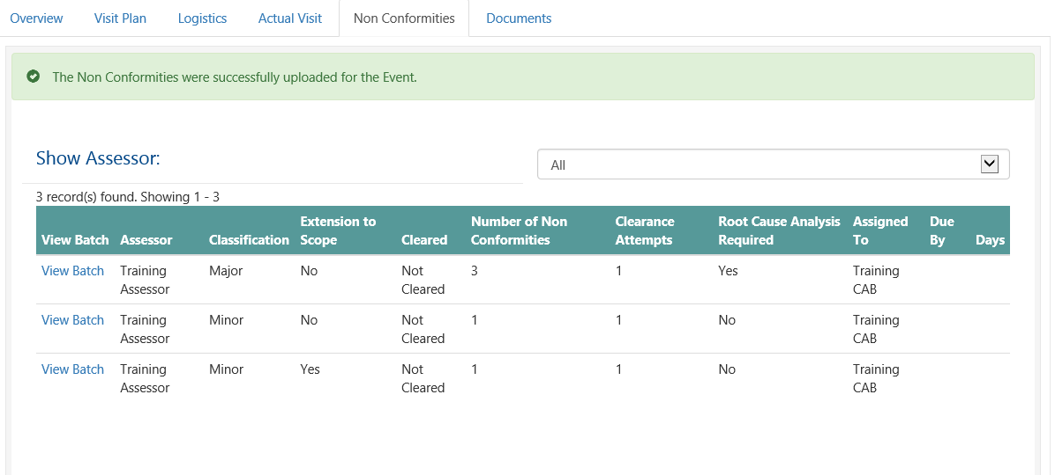
On the day

Slide 31
On the day
I have no non-conformities

Slide 32
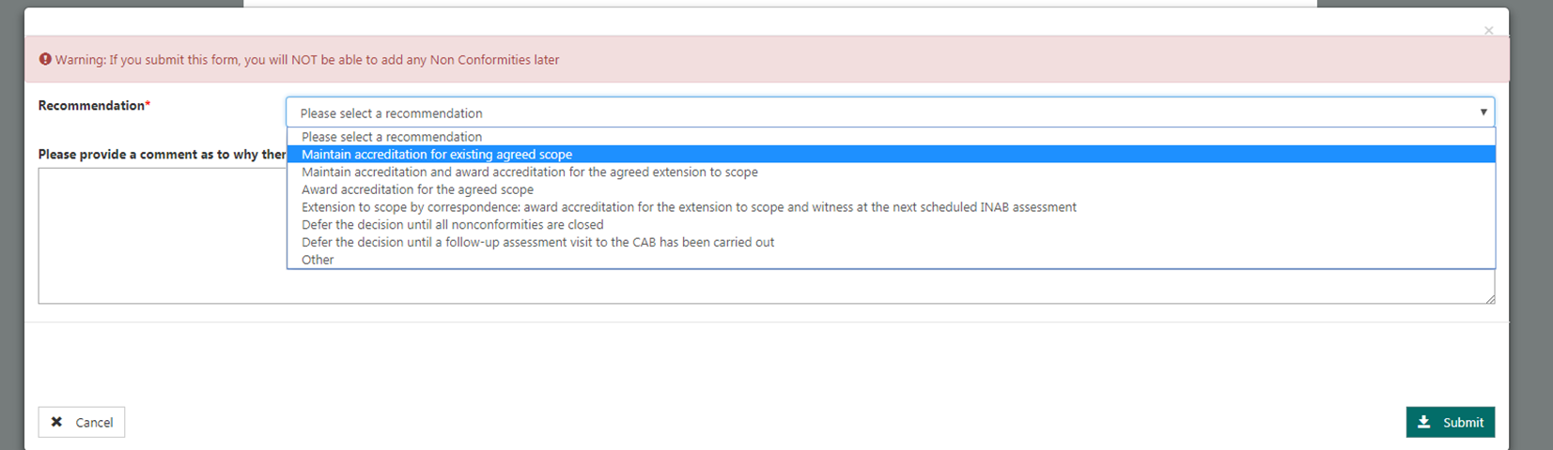
On the day

Slide 33
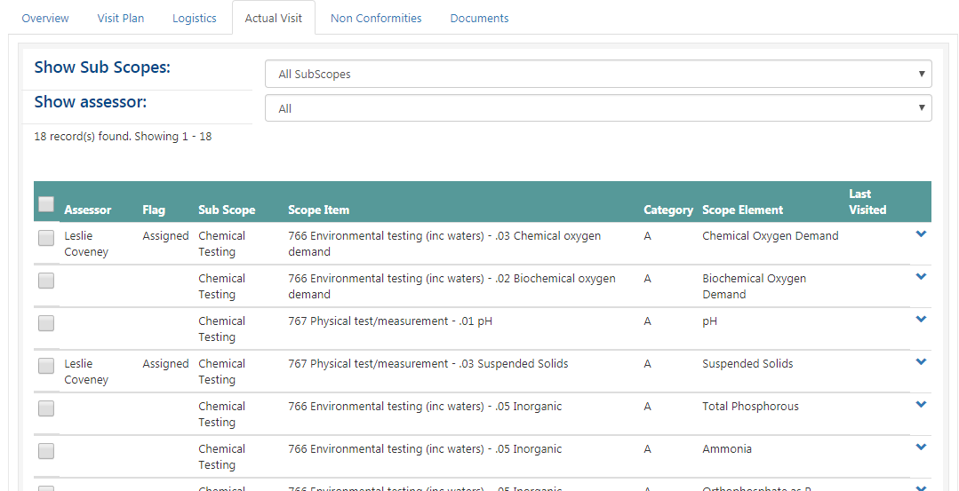
On the day
Confirm witnessed tests

Slide 34
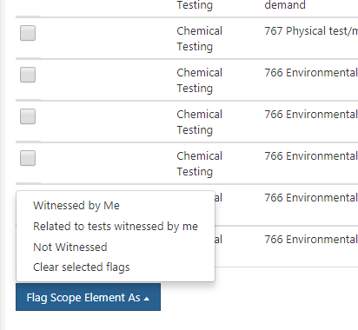
On the day

Slide 35
On the day
Upload audit trail report

Slide 36
Submitting expense claims
Visit/event status
Currency conversion
Expense items
  Daily rate
  Travel – mileage/hire car/ ticket
Receipts
Reviewed by Officer and Manager
  Submitted
  Then rejected or paid

Slide 37
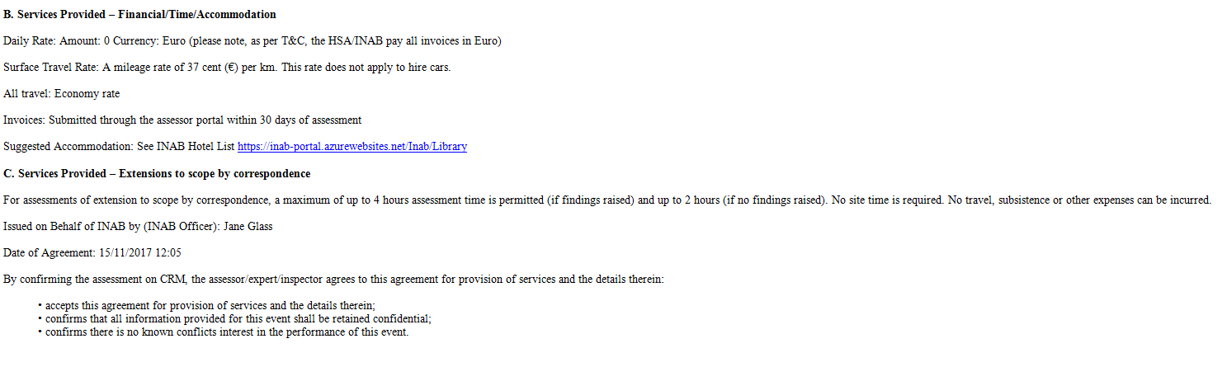
Submitting expense claims

Slide 38
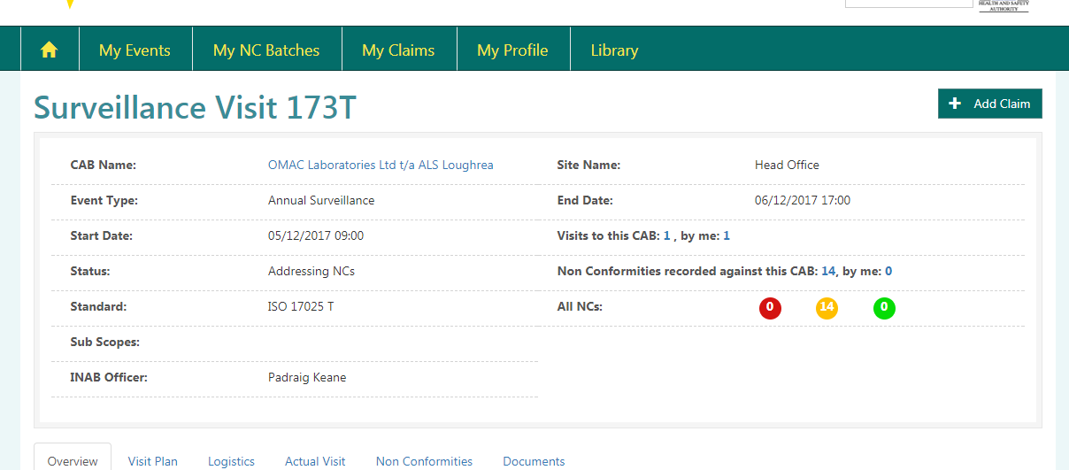
Submitting expense claims
When visit has been completed…

Slide 39
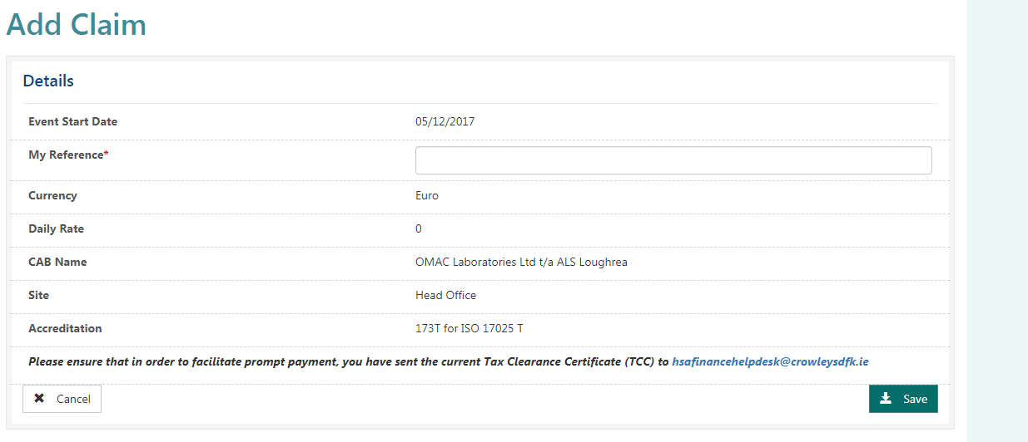
Submitting expense claims

Slide 40
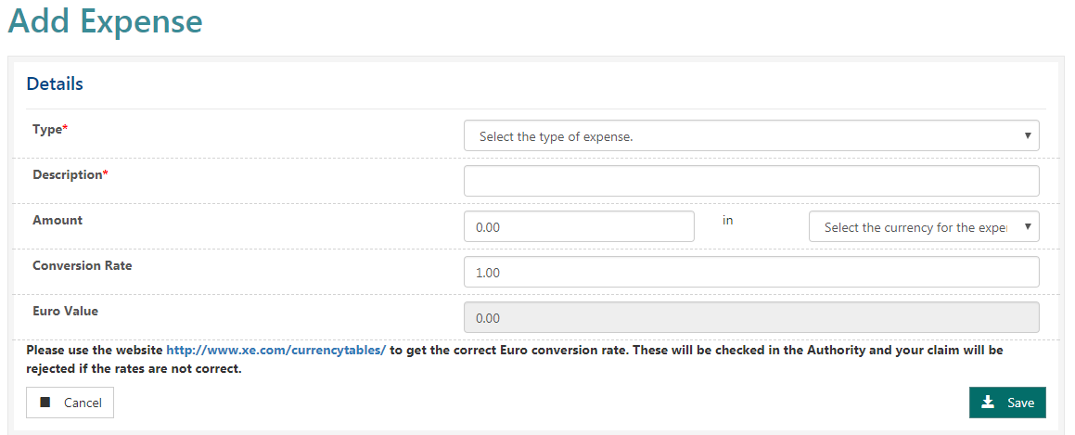
Submitting expense claims

Slide 41
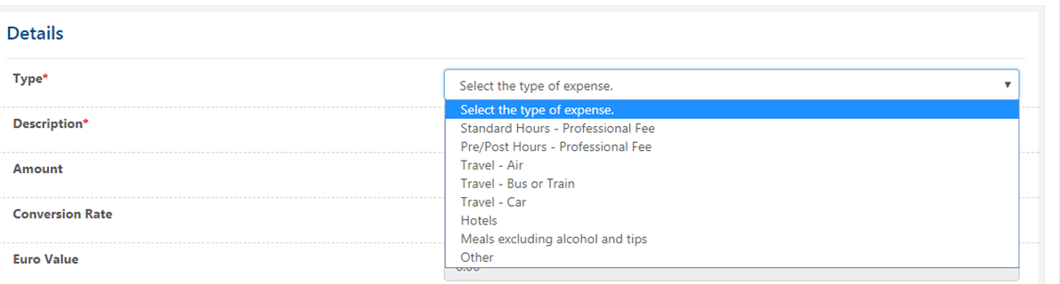
Submitting expense claims

Slide 42
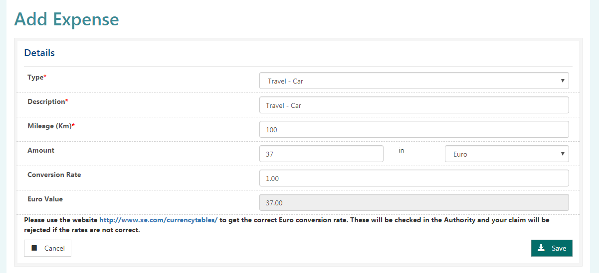
Submitting expense claims

Slide 43
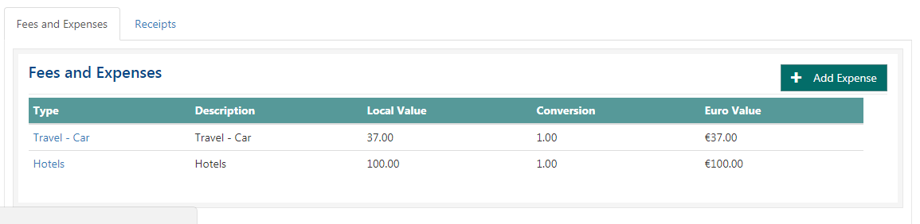
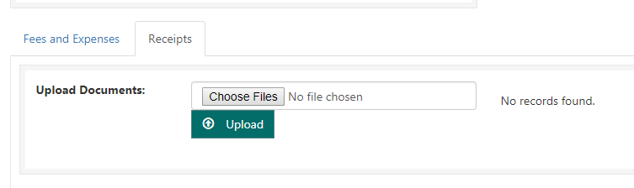
Submitting expense claims

Slide 44
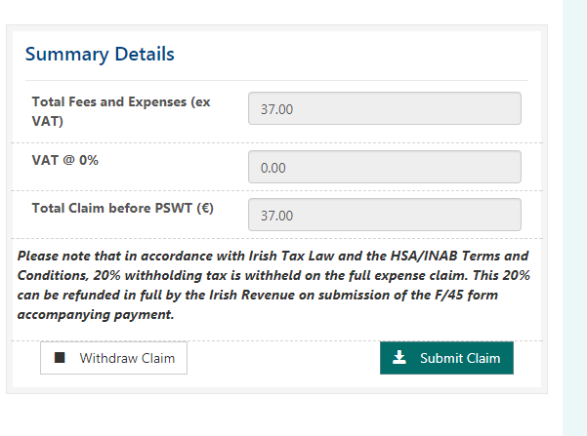
Submitting expense claims

Slide 45
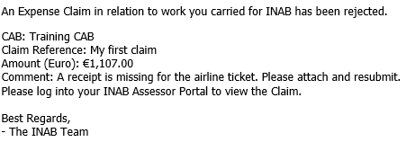
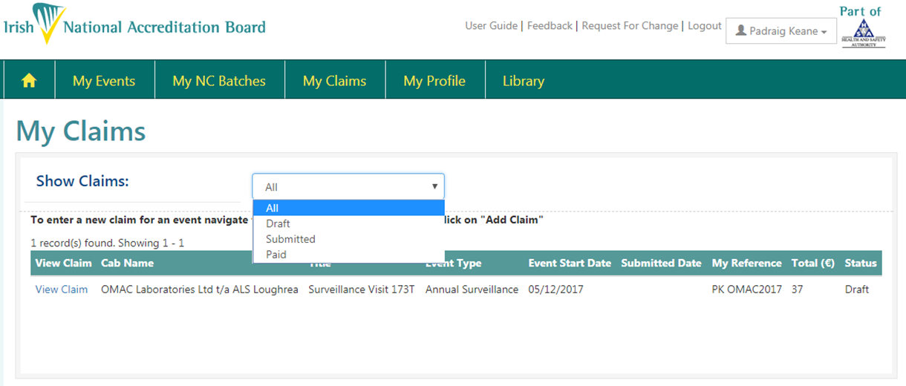
Submitting expense claims

Slide 46
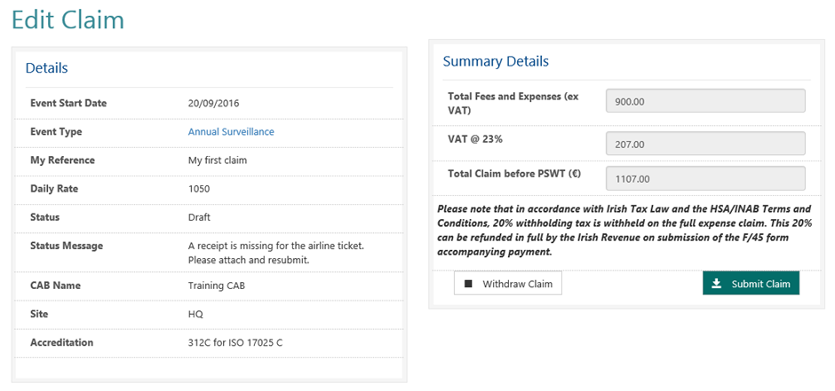
Submitting expense claims

Slide 47
Submitting expense claims
Claim submitted in error
Guides
  Agreement
  INAB Hotels March 2016
  Schedule A-1 Business Rules for INAB Assessors
    Revision 2 – Sept 2017
  INAB Hotels March 2016

Slide 48
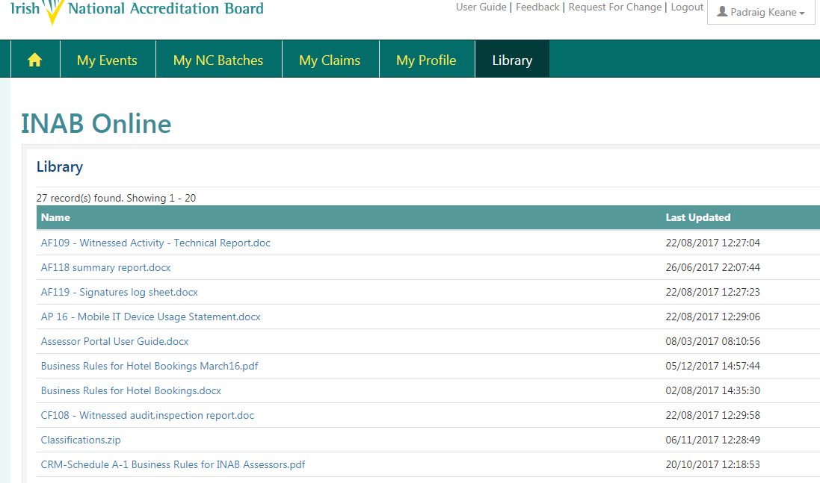
CRM portal library

Slide 49
NC review and clearances
Edit details
View documents
  RCA, CAPA report…Evidence??
Comment
  Cleared/not cleared
  Second attempt required
Recommendation
SUBMIT TO INAB!

Slide 50
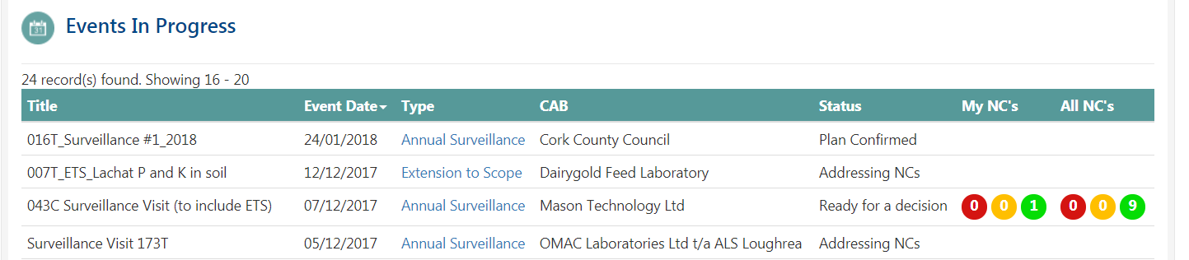
NC review and clearances

Slide 51
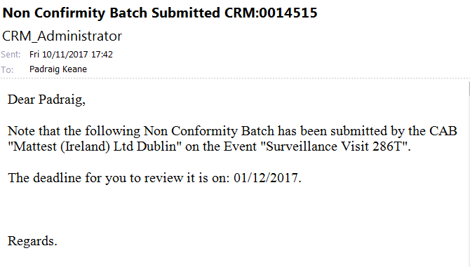
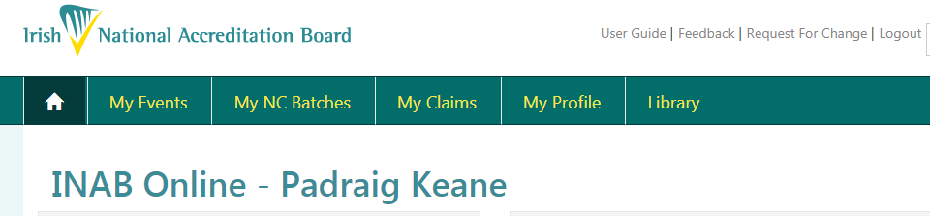
NC review and clearances

Slide 52
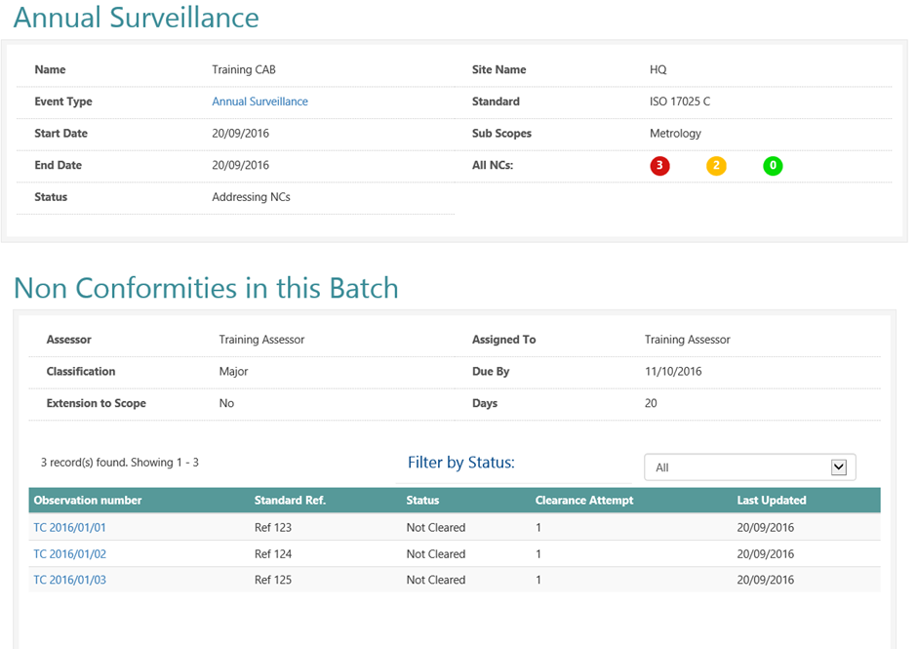
NC review and clearances

Slide 53
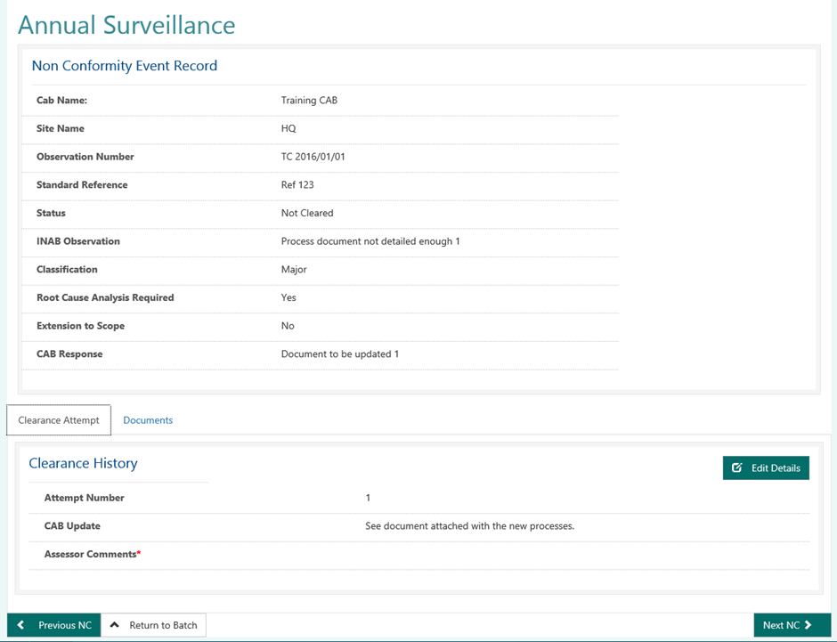
NC review and clearances

Slide 54
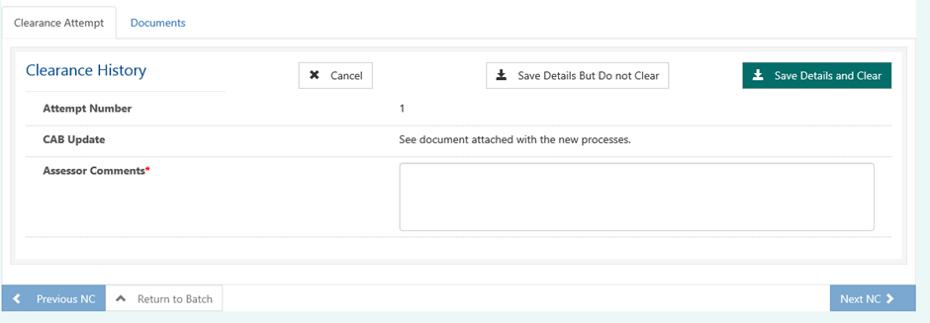
NC review and clearances

Slide 55
NC review and clearances

Slide 56
NC review and clearances

Slide 57
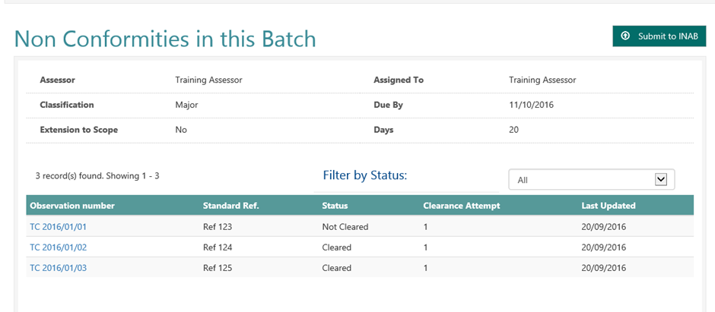
NC review and clearances

Slide 58
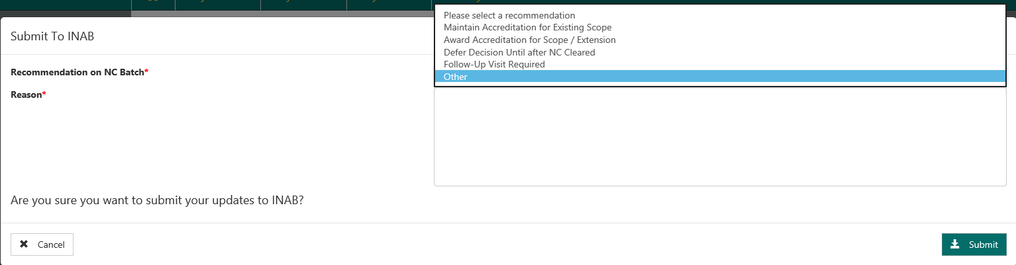
NC review and clearances

Slide 59
Feedback and Improvements

Slide 60
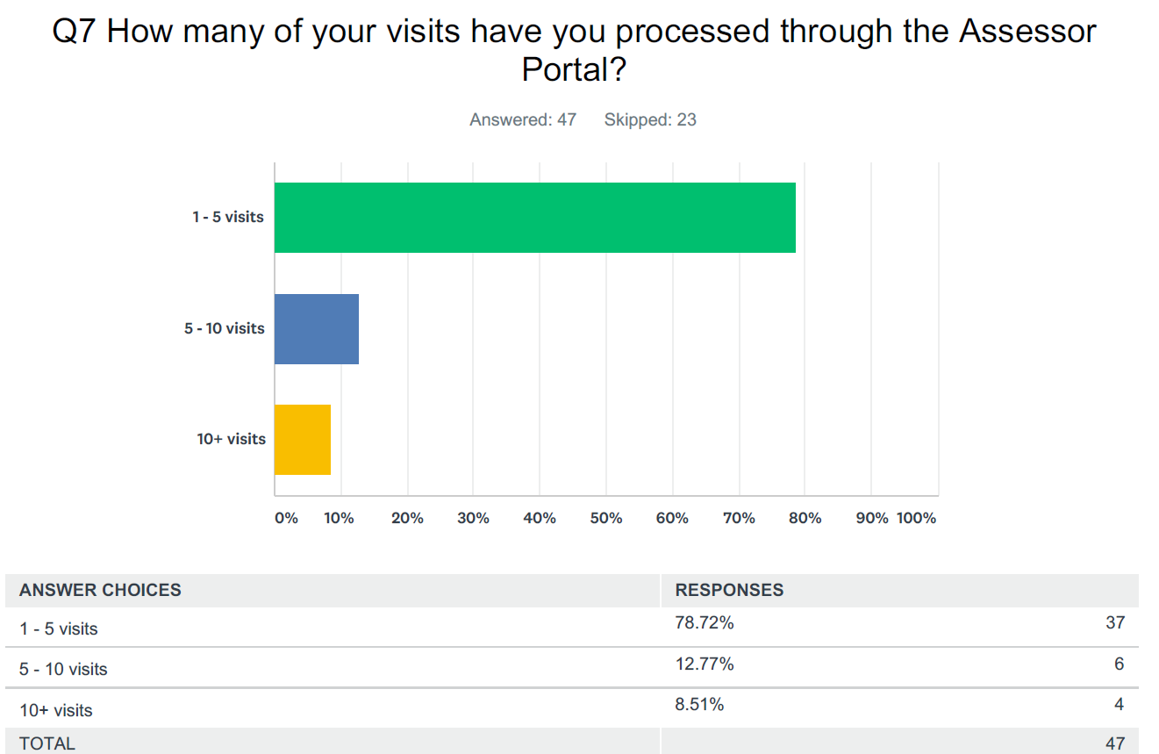
Feedback – CRM Survey results

Slide 61
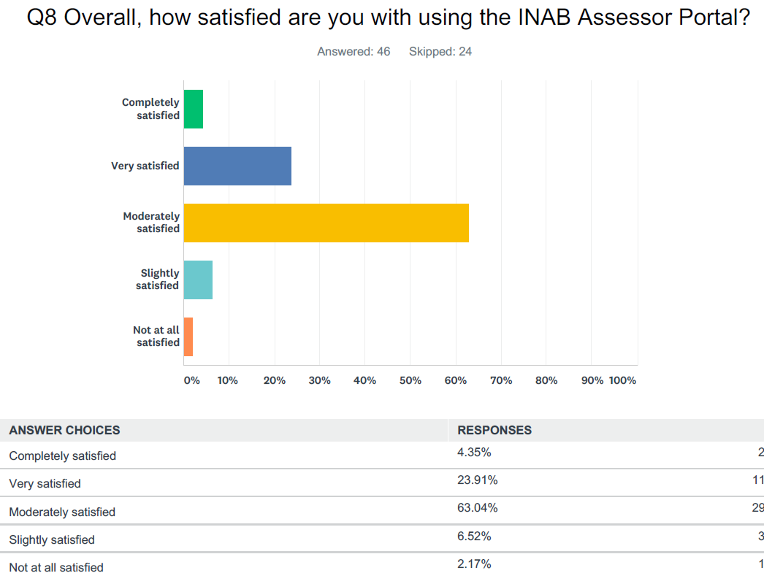

Slide 62
Feedback – assessor forum survey
One shot at NC upload, no mistakes
Downloading PS10 – PS10 changed, CABs requested to upload zip files.
Claim – error, print.
Really like system
No issue
Portal Performance – Speed, timing, loading

Slide 63
Improvements
Portal Performance Review
  Servers – moved from US to Europe
  Investigation – monitoring tool
New Non Conformity Template
Allows copy and paste, no restrictions
Finance
  My Reference field on CRM under claim - appears on payment
  Monitoring alert system for payments not processed within a 2 hour frame.

Slide 64
Helpful hints and tips
Deleting Documents – Request via INAB.
ADD CLAIM – only when status of event at Addressing NCs; Ready for Decision or Closed!
Locked out of the portal – wait 5 minutes as the account automatically unlocks
All Portal users must redeem invite before they can start using the portal.
Link in registration email.
Avoid & and other special characters in file names.

Slide 65
Helpful hints and tips
NC template – assessor must download own template from their portal
NC template download – available at Plan Confirmed status
Unable to save NC Template – ensure file name not too long c:\ counted as part of title (218 characters max).

Slide 66
Thank you

Slide 67
Breakout Groups
17025 / 15189 | Brid Burke | main room
New Assessors introduction to INAB Group 1 hour -then revert to their own standard break out group. | Marie O’Mahony
Inspection/Ref Materials | Pat O’Brien
Certification | James Stapleton

Slide 68
Policy on nonconformity management (and other stuff)
Andrew Stratford

Slide 69
Before revision of ISO 17011
INAB’s policy:
Major NCs required root cause analysis
Assessment team could choose whether or not root cause analysis was required for minor NCs
Documentary evidence always

Slide 70
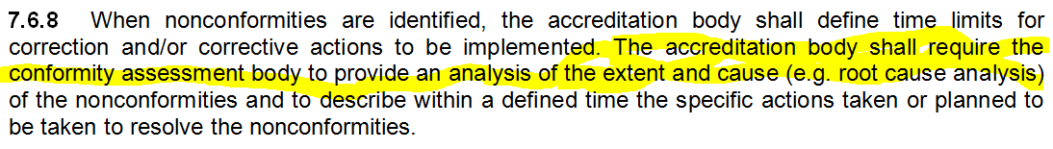
Publication of new ISO 17011

Slide 71
New INAB policy
In all cases, INAB now requires
Submission of analysis of extent and cause
Description of action planned to be taken or already taken to resolve the NC
Assessors can’t close the NC until this is received
Evidence is not automatically required…

Slide 72
New INAB policy
Minor NCs - surveillance
Assessor who raises NC decides whether or not evidence is required (at discretion of assessor, but default is no evidence required)
Major NCs, NCs at initial assessment and NCs related to extensions to scope
Must have evidence of implementation of actions

Slide 73
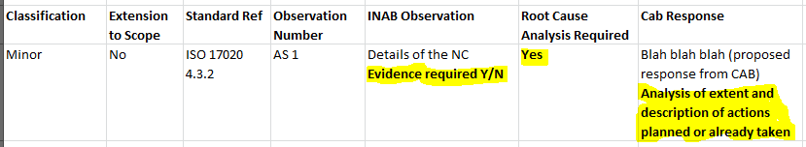
A niggly-naggly problem
Excel spreadsheet doesn’t currently handle this

Slide 74
Summary
Minor NC; CAB to provide:
Analysis of extent and cause (mandatory)
Description of actions taken or planned to be taken (mandatory)
Evidence of implementation of actions (optional, at the discretion of the assessor)

Slide 75
Summary
Major NC, NCs from initial assessments or extensions to scope; CAB to provide:
Analysis of extent and cause (mandatory)
Description of actions taken (mandatory)
Evidence of implementation of actions (mandatory)

Slide 76
That’s all for NCs
Next: sampling of requirements from accreditation standards.

Slide 77
Sampling – before:
INAB policy was to try to cover as many of the clauses of the accreditation standard as possible.
Sampling – new:
Some elements, such as internal audit, management review, etc. are assessed every time, but…

Slide 78
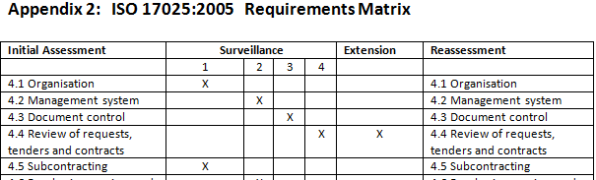
Sampling – new:
INAB policy is now to cover a sample of clauses, based on matrices for the different accreditation standards

Slide 79
Sampling
A matrix has been developed for every accreditation standard.
The lead assessor will use the relevant matrix when formulating the visit plan
The plan is to assess fewer clauses at each surveillance visit, but there may now be time to look at them in more depth

Slide 80
That’s all for sampling
Next: amended INAB forms

Slide 81

Amended INAB forms
Despite the introduction of the CRM for handling the assessment process, the old familiar report forms such as the X116 and AF118 forms will remain

Slide 82
Amended INAB forms
You’ll notice a few tweaks in these forms to reflect the handling of NCs through the CRM portal, but otherwise, no significant changes; we still have to record what we’ve seen
The forms are a bit flaky in places, but please bear with us; we are working on a complete revamp of key forms - cool new ones are on the way

Slide 83


Slide 84
Questions?

Slide 85
What is new in INAB
Pat O’Brien

Slide 86
(1) New structure of INAB
INAB comprises 13 staff
INAB Manager
3 Scheme mangers
8 Accreditation Assessment Mangers
QM
1 Project Executive
2 Administration

Slide 87
(1) New staff in INAB
PADRAIG KEANE, Assessment Manager Joined INAB in March 2017.
JONATHAN CARSON, Executive Officer Joined INAB in March 2016.
JANE GLASS, Clerical Officer Joined INAB in March 2017.

Slide 88
(1) Scheme Mangers
Scheme areas - based on MLA – 3 Scheme Managers.
ISO 17025, ISO 15189, ISO 17043
ISO 17021, ISO 17065 and ISO 17024
ISO 17020, ISO 17034

Slide 89
(1) Scheme Manager Role
Role:- responsible for all matters relating to the management of the assigned accreditation schemes
Responsibilities:- e.g. technical and policy issues, implement any changes, bring items for discussion within INAB to ensure harmonisation, Advise on the necessity for documents and development

Slide 90
(1) INAB Board
The INAB Board is established as a permanent committee of the Health and Safety Authority
- The Board comprises 12 persons

Slide 91
(2) New Scheduling Unit – how it works
Why ! introduce scheduling efficiencies
process is managed and driven by the INAB Administration with input from assessment managers
The normal running schedule is to work as far in advance as possible and no less than 3 months in advance

Slide 92
(2) New Scheduling Unit – how it works
Communications will be by email, phone, etc as necessary and key decision communication processed within CRM
  Once the date has been agreed by all parties, an event is set up in CRM by Administration who will then send agreements to all parties, including the Accreditation Officer as lead assessor.
The agreements will have the standard p/p time of 4 hours automatically included.

Slide 93
(2) Key points of the policy
INAB Administration will ensure the PS10 documentation is submitted,
Assessment Managers provide all information needed to enable a visit to be scheduled in a timely manner,
-will document all visit logistics (start, end times etc)
- responsible for issuing all visit plans (VP). Until such time as the scope elements are in CRM, the VP can be issued by email through the CRM.

Slide 94
(3) Role of the Assessment Team
The INAB assessment team comprises a Lead Assessor and/or a Technical Assessor(s)/Technical Expert(s) and an INAB Officer.
The assessment team is responsible for providing INAB with a recommendation on accreditation on completion of the visit.
The assessment team recommendation must be supported by evidence collected by the team during the visit

Slide 95
(3) Team functions within CRM
Lead assessor /Technical assessor / Expert
Confirm Availability
Review application or Accreditation and history, documents uploaded to an event
View the Visit Plan, assign scope elements, event Logistics, undertake Actual Visit and record scope elements,
Download NC template and upload to CRM
Review CAB Corrective actions on NC and respond
Upload documents to an event

Slide 96
(3) Role of the Assessment Team
The INAB accreditation assessment manager is now the Lead assessor and undertakes the opening and closing meeting, and reviews the management systems, also ensures that the team is thorough, professional, fair and objective as per the INAB Code of conduct (PS8) and to ensure that all relevant aspects of the standard and INAB requirements are reviewed in sufficient depth as per the visit plan.
Technical / experts to assess the technical competence of the client conformity assessment body (CAB) and its compliance with the relevant international standard(s)/requirements for a specific scope

Slide 97
(4) PS10 content and review
This statement sets out the Irish National Accreditation Board policy on the submission of documents by a Conformity Assessment Body (CAB – laboratory, certification and inspection body, reference material producer) to INAB, prior to an assessment/surveillance/re-assessment visit or scheduled witnessed activity.

Slide 98
(4) PS10 - CAB submission timeframe
CABs provide the information to INAB six weeks prior to a scheduled surveillance visit, and six months prior to a to a scheduled extension to scope assessment
All PS10 documentation submitted to INAB must be uploaded to INAB CRM via the Client Portal.
A zipped folder with all documents for each team member

Slide 99
(4) Doc’s required for each TM on visit day
  Quality manual and any amendments
  Schedule of all audits
  issued report/certificate
  Register and summary of non- conforming work investigation
  Primary sample collection manual (ISO 15189 only);
  A review of compliance with mandatory documents (INAB DC1 refers)
  Identification of all relationships with related organisations
  A documented impact/risk analysis on impartiality and independence of CAB activities.
Notes:
CAB submit in advance for initial assessment and reassessment and for all other visits documents are available at the start of the visit.
A documented impact/risk analysis on impartiality and independence of CAB activities. May not be applicable for laboratory accreditation

Slide 100
(4) Documents For Submission: ALL CABs
  Minutes of last Management Review
  Organisation chart; highlighting changes
  Current list of key personnel and deputies and changes;
  Details of activity related to scope of accreditation and how the CAB manages the maintenance of competence in areas where there has been no activity;
  Current schedule of quality and technical meetings;

Slide 101
(4) Documents For Submission: ALL CABs
  Details of all critical and foreign locations where activities are carried out or where offices are located;
  A review of the relevant legislation affecting your scope of accreditation.
  Records and CAB conclusions of the audit of the effectiveness of the corrective actions implemented in response to the nonconformities raised at the previous INAB assessment.

Slide 102
(4) Additional for Laboratories
Proficiency Testing 5 year plan and performance
  investigation reference number for any out of specification results with a brief summary of conclusions;
Those operating a flexible scope of accreditation, the current version of the Master List of Flexible Scope Changes
process flow diagram from sample receipt to reporting
current list of blood fridges, a summary report of blood usage and a list of notifications to the National Haemovigilance Office

Slide 103
(4) Additional for Laboratories
Where applicable, a summary of amendments to accredited test methods since the previous visit.
For laboratories applying for an extension to scope; the current validated procedures and validation/verification summary report

Slide 104
(4) Reference Material Producers (RMP)
  Changes to key authorized competent personnel that perform particular activities relating to RM production. (Personnel, including subcontractors, personnel of external bodies, or other individuals acting on the RMP’s behalf);
  Where an RMP uses subcontractors to undertake part of the production, include any changes to sampling, processing, handling, homogeneity and stability testing, characterization, storage or distribution of an RM,

Slide 105
(4) Reference Material Producers (RMP)
  RMP shall submit any changes to the planning stage or deviations from the production plan or the metrological traceability of the certified values or characterization study.

Slide 106
(4) Certification & Inspection Bodies H/O
Changes to the impartiality committee or involvement with related bodies
  Details of new certificates issued with associated EA sector or technical area;
  Details of amendments to technical standards in response to legislative updates
  List of personnel authorised as competent in the conformity assessment activities
  List of approved sub-contractors

Slide 107
(4) Witnessed activities (CB and IB)
Copy of the audit plan
Previous client audit report completed by the CB/IB
Location of, and directions to, the witnessed activity, with contact details for on-site personnel
Details of audit/inspection duration determination/calculation
A copy of the audit/inspection procedure and the working documents used by the auditor/inspector.

Slide 108
Thank you for your attention

Slide 109
Assessor Management
Marie O’Mahony

Slide 110
Assessor Management
What’s new?
New business model in INAB (2017)
- CRM for visits management
- INAB Lead Assessor
- CRM generated assessor contracts
CRM tool for Assessor Qualification (go live Feb 2018)

Slide 111
Assessor Management
What’s new?
ISO 17011 Rev 2 – (competency criteria)(Nov 2017)
New Mandatory IAF MD20 (Jan 2018 implementation)
Competencies model – A ; B; C; D.

Slide 112
Assessor Management
Result:- Development of new Assessor Management processes
- Qualification and Competency management
- Training programme
Monitoring programme
Assessor records management

Slide 113
Assessor Management
Defined minimum competency criteria
Educational- Degree level
Work experience in technical sector (4 years)
Assessor training in standard
CPD – (e-learning/assessments/
membership of professional body/committees )

Slide 114
Assessor Management
Training Programme
Induction training
Training of technical experts
Identification of training needs/Refresher training
Updates /notifications/Publications

Slide 115
Assessor Management
Monitoring Programme -3 year cycle – Rolling schedule
Combination of :
On-site Monitoring
Reports Review (findings/assessment reports/recommendations)
Client feedback on assessment team performance post decision
Against the defined competency criteria
(A;B;C;D).

Slide 116
Assessor Management
Monitoring Programme
3 year cycle – Rolling schedule
- Annual Assessor Performance Review of monitoring schedule
Evaluation and decision will be completed at end of Year 3
Feedback to assessor/expert following evaluation

Slide 117
Assessor Management
Assessors Records Management
New CRM tool for qualification of applicant assessors/experts and extension of competencies for active assessors/experts.
New Assessors/experts - All records will be in CRM
(Educational qualifications/relevant training certificates/CRM classifications /Contracts)
Existing active assessors/experts - combination of hard copy and electronic records combination currently

Slide 118
Assessor Management
Assessors Records Management
For effective records management and to ensure records are current :-
Can Active assessors/experts please complete Profile in CRM when qualification tool is live
Instructions will be updated in CRM assessor portal manual
INAB will send notification with request to complete
in timeframe of go-live date + 2 months.

Slide 119
Feedback
Marie O’Mahony

Slide 120
Feedback
Stakeholder Feedback
Client Feedback
Annual Assessor Performance Review Feedback
Evaluation feedback for Assessors/experts
Positive and negative feedback captured

Slide 121
Other Feedback
Other Specific Categories of Feedback
Complaints
Visit – AF119 (log of issue).
Right of Reply (on recommendations)
Appeals (Adverse decision on accreditation status)
INAB Policy - PS25 on Feedback mechanisms

Slide 122
INAB Stakeholder Feedback
Summary of Feedback received in 2016 -2017:
 | 2016 | 2017
Client Feedbacks | 20 | 18
Complaints | 3 | 1
Appeals | 1 | 0

Slide 123
Client Feedback Examples 2016
Queries/Clarifications/Suggested Amendments to INAB Policy statements/application forms (PS 11; PS23; PS 8)
Queries/clarifications on INAB/Standards requirements
Negative experience from end users of accredited services from CABs (laboratories/inspection bodies/certification bodies)
Negative feedback on conduct of INAB team at visits
Positive feedback on added value provided by INAB team at visits

Slide 124
Client Feedback Examples 2016
Negative feedback on INAB not accrediting blood cultures to Irish guidelines
Raising of ncs against guidelines and not the standard
Disagreement with recommendations of INAB team
Negative feedback on fees
Delays in arranging extension to scope visit

Slide 125
Client Feedback Examples 2017
Discrepancies on website
Negative feedback on member of INAB team
Lack of appreciation of aspects of medical laboratory services
Lack of sufficient INAB team planning re witnessing on visit
Feedback on inconsistency of CB auditors in an INAB accredited CB
Positive feedback on teams /
Positive feedback on CRM

Slide 126
Client Feedback Examples 2017
Queries on flexible scope assessment
Dissatisfaction at removal of blood cultures from scope
No of assessor days for IB assessment/ Use of logo on vehicles
Accreditation of Irish legal entities by UKAS/A2LA
Omission of specific clause in standard scheme for accredited CBs
Delays in responses to corrective actions

Slide 127
Client Feedback Outcomes
Investigated directly with clients and followed up to ensure issue was addressed as per standard requirements
Application forms updated to allow CABs highlight specific regulatory/mandatory requirement deadlines
Introduce new INAB Policy Statement to clarify provision of accredited /unaccredited services by INAB accredited testing and calibration laboratories – PS23
Update relevant INAB Policy statements to provide clarification/Amendment

Slide 128
Client Feedback Outcomes
Additional visit to accredited CAB to evaluate submitted feedback provided by end-user. Presented outcome to Board of INAB.
Outcomes from investigations provided to stakeholders presenting conclusions and recommendations.
Positive Feedback presented to teams/team members
Negative feedback presented to Teams/team members
Clarifications to client where investigation
concluded that no evidence to support stakeholder claim.

Slide 129
Client Feedback Outcomes
INAB Medical Advisory Committee assigned Microbiology TFG to evaluate Irish Guidelines on blood cultures
Invited stakeholder to give presentation to INAB Medical Advisory Committee on specific medical laboratory aspects to put on annual workplan of committee.
Corrected website discrepancies and carried out audit.
Clarifications provided directly to stakeholders on INAB policy and on current status regarding a number of issues
(eg flexible scope, use of logo on vehicles etc)

Slide 130
Client Feedback Outcomes
INAB Regulations updated to address a number of issues (use of logo on vehicles, additional visits within required timeframes)
Notifications issued in relation to accreditation of blood cultures to revised Irish guidelines.
Transition arrangements introduced to include previously excluded clause from standard scheme.

Slide 131
Annual Assessor Performance Review Feedback
Assessment teams are performing to a high standard
Clients are recognising added value
Teams are implementing CRM system well
Some issues in relation to
submission of reports post visit
Review of submitted corrective actions/action plans
Assessor records updates

Slide 132
Annual Assessor Performance Review Feedback
New Assessor Monitoring Process and 3 year Monitoring Programme being introduced in 2018
Thank you for your important contribution to the delivery of INAB’s accreditation service to date
Thank you for co-operation with the significant number of changes in INAB in 2017
Thank you for your continued co-operation

Slide 133
ISO 17011 Revision
Summary of key changes
Marie O’Mahony

Slide 134
ISO 17011 Revision
“Conformity assessment – Requirements for accreditation bodies accrediting conformity assessment bodies”
Alignment with Casco Common Structure for standards
- Incorporation of CASCO common elements in clauses on :-
Impartiality, Confidentiality
Complaints, appeals (Mandatory wording)
Management system (Options A and B)

Slide 135
ISO 17011 Revision
Removal of Proficiency testing and other comparisons for laboratories:
Too specific
- EA/ILAC MLA documents to address

Slide 136
ISO 17011 Revision
Scope now allows for other “Accreditation Schemes” to be covered
Reference Material Producers/Proficiency Testing Providers/Verification and validation/other in note
Addition of new definitions :
-Accreditation scheme
-Flexible scope of accreditation
-Remote assessment
-Assessment programme

Slide 137
ISO 17011 Revision
Introduction of the concept of risk
- representative sampling
Incorporation of Competence Criteria for all AB personnel into standard with informative Annex A on knowledge & skills for performing accreditation activities

Slide 138
ISO 17011 Revision
Very brief summary of key changes
3 year transition period
Current Gap Analysis in progress
Peer evaluation in Sept 2018 will be to new Revision

Slide 139
INAB Assessor Forum
EA Peer Evaluation

Slide 140
European Accreditation Peer Evaluation Process
EA appointed by EU Commission to manage the Accreditation framework.
Key component of Framework is Peer Evaluation Process.
This process demonstrates the competence and reliability of all MLA signatory Accreditation Bodies.
INAB next scheduled Peer evaluation 24th -28th Sept 2018
INAB will be assessed against MLA requirements and ISO 17011 Rev 2.

Slide 141
INAB EA MLA Scope
INAB is EA MLA signatory for :-
-Testing (including medical testing)/Calibration
-Inspection
-Management System Certification/ Product Certification
In 2018 – plan to extend to include Reference Material Producers
– ISO 17034
International recognition of all reports and certificates issued by INAB accredited Conformity assessment Bodies

Slide 142
EA Peer Evaluation Process
Dates confirmed – 24th -28th September 2018
Against ISO 17011:2017 Rev 2; EU Reg 765/2008; EA/ILAC/IAF mandatory documents
Team of international Accreditation Body peer experts
35 man-days reviewing INAB systems and processes and records
Findings:- NCs, Concerns, Comments
Decision taken at EA MAC

Slide 143
INAB EA Peer Evaluation Process
Head Office Assessment – Monday ; Thursday; Friday
- INAB Policies/Processes/Quality Management System Records
- Technical File Records - File reviews over accreditation cycle
On-site Witnessing of Assessment Teams on visits – Tuesday to Wednesday
- INAB teams evaluation of applicant /accredited CABs
Different CABs and different teams where possible
Risk based approach –Accreditation Cycle (Standard and scope of accreditation)

Slide 144
INAB EA Peer Evaluation Process
Current topics/focus:
- Accreditation cycle – coverage of standard and scope of accreditation
Notified bodies/flexible scopes
Assessor/Decision-maker competencies
Transitions to revised standards
Implementation of EA/ILAC/IAF mandatory documents
Impartiality/confidentiality/conflict of interest issues

Slide 145
INAB EA Peer Evaluation
Some issues to consider
Review and update profile in CRM
Prepare well
Have relevant documentation (DC 1)/standard/Mandatory docs/forms/scope etc
- Lead assessor will introduce team evaluator and explain role as silent observer
Perform as normal and follow visit plan- pay attention to time management

Slide 146
INAB EA Peer Evaluation
Factual findings and recommendation with justification
Do not engage observer in assessment
Ensure the CAB does not engage the team member in assessment
Answer his/her queries at private breaks/coffee
Technical experts – supervision and consultation with LA on findings to determine categorisation.
Remain focussed and remember you are capable competent ,
experienced teams, who are representing INAB .

Slide 147
INAB EA Peer Evaluation
Enjoy the experience

Slide 148
General Data Protection Regulation
(GDPR)
Frank Crowe

Slide 149
What I will talk about today
Data Protection Act
What is Personal Data
Data Protection Principles
Key Terms
General Data Protection Regulation (GDPR)
Why should we care about the GDPR
Going forward

Slide 150
The Data Protection Act
The Data Protection Acts 1988 and 2003 are based around eight principles of good information handling.
These give people specific rights in relation to their personal information and place certain obligations on those organisations that are responsible for processing it.

Slide 151
What is Personal Data
Personal data means data which relate to a living individual who can be identified
From those data, or
From those data and other information which is in the possession of, or is likely to come into the possession of, the data controller.
UK Information Commissioner’s Office

Slide 152
8 core principles of data protection
They Set out the main responsibilities for organisations.
Obtain and process the information fairly
Keep it only for one or more specified and lawful purposes
Process it only in ways compatible with the purposes for which it was given initially
Keep it safe and secure
Keep it accurate and up-to-date
Ensure that it is adequate, relevant and not excessive
Retain it no longer than is necessary for the specified purpose or purposes
Give a copy of his/her personal data to any individual, on request

Slide 153
Key Data Protection Terms
Processing – any operation or set of operations which is performed on personal data.
Data Subject - a natural person whose personal data is processed by a controller or processor.
Data Controller - the entity that determines the purposes, conditions and means of the processing of personal data.
Data Processor - the entity that processes data on behalf of the Data Controller.

Slide 154
GDPR
The European Union's General Data Protection Regulation comes into effect on 25 May 2018 and harmonises 28 DP Laws across the EU.
The main purpose of GDPR is to give EU citizens greater control over how their personal data is collected, protected and used.

Slide 155
8 principles condensed into 6
Obtain and process the information fairly
Keep it only for one or more specified and lawful purposes
Process it only in ways compatible with the purposes for which it was given to you initially
Keep it safe and secure
Keep it accurate and up-to-date
Ensure that it is adequate, relevant and not excessive
Retain it no longer than is necessary for the specified purpose or purposes
Give a copy of his/her personal data to any individual, on request
Lawfulness, fairness and transparency
Purpose limitations
Data minimisation
Accuracy
Storage limitations
Integrity and confidentiality
Rec.59; Article.12(2)
Controllers have a legal obligation to give effect to the rights of data subjects.

Slide 156
GDPR – New Accountability
Introduces new accountability obligations for any organisation that handles data about EU citizens - whether that organisation is located in the EU or not.
And places stricter responsibilities on organisations to prove they are adequately managing and protecting personal data.

Slide 157
GDPR widens the definition personal data
While the definition of personal data has always been fairly wide, the GDPR broadens it even further.
The GDPR considers any data that can be used to identify an individual as personal data. It includes for the first time, things, such as, genetic, mental, cultural, economic or social information.
From 25 May, hardly any personal data will not fall under the GDPR, making it difficult for organisations to avoid having to comply with its requirements.

Slide 158
GDPR - A Regulation not a Directive
What is the difference?
A regulation is a binding legislative act. It must be applied in its entirety across the EU.
In contrast to the current DP directive the GDPR is intended to apply directly in each EU member state without the need for implementing legislation.

Slide 159
GDPR applies to all
  The GDPR not only applies to organisations located within the EU but it will also apply to organisations located outside of the EU if they offer goods or services to, or monitor the behaviour of, EU data subjects.
  It applies to all companies processing and holding the personal data of data subjects residing in the European Union, regardless of the company’s location.

Slide 160
GDPR and UK
On September 13 2017, the U.K. government introduced in Parliament the Data Protection Bill. The main aim of the bill is to implement the General Data Protection Regulation into U.K. domestic law.
With the deadline for Brexit not until 31 March 2019, the GDPR will be effective in the UK for more than ten months.

Slide 161
Why should we care about GDPR
Increased Administrative Overheads
GDPR is a more rigorous specification than the current data protection act which means more detailed and onerous obligations are imposed on organisations.

Slide 162
Why should we care about GDPR
1. Consent
  In general you have to have a data subject’s consent to process their data.
  While there are specific circumstances in which consent is not strictly necessary, these generally revolve around legal requirements, such as, compliance with another law or where the data subject’s consent is provided through a contract.

Slide 163
Why should we care about GDPR
1. Consent
  Data controllers will have to ensure that they secure clear and unambiguous consent from the data subject before processing personal data.
  Critically, the data controller is not permitted to count, silence, pre-ticked boxes or inactivity as consent. It has to be freely given, specific, informed and unambiguous.
  The data subject has the right to withdraw consent at any time.

Slide 164
Why should we care about GDPR
2. Right to erasure (‘right to be forgotten’)
  The broad principle underpinning this right is to enable an individual to request the deletion or removal of personal data where there is no compelling reason for its continued processing.

Slide 165
Why should we care about GDPR
3. Data Breach Notification
  The GDPR introduces a common data breach notification and is aimed at ensuring organisations constantly monitor for breaches of data protection.
  The regulation requires organisation to notify the local data protection authority of a data breach within 72 hours of discovering the data breach.

Slide 166
Why should we care about GDPR
4. GDPR expands liability beyond data controllers
  In the past only data controllers were considered responsible for data processing activities, but the GDPR extends liability to all organisations that touch personal data.

Slide 167
Why should we care about GDPR
5. Massive Fines
General conditions for imposing administrative fines
  The GDPR gives supervisory authorities the power to issue fines of up to:
    20 million or 4% of annual global turnover - whichever is greater.

Slide 168
Why should we care about GDPR
6. Access Right
  Also known as the Right to Access, it entitles the data subject to have access to and information about the personal data that a controller has concerning them.

Slide 169
Why should we care about GDPR
7. Data Portability
  The requirement for controllers to provide the data subject with a copy of his or her data in a format that allows for easy use with another controller.

Slide 170
Increased Administrative Overhead
Processing personal data under the GDPR puts a considerable administrative overhead on any organisation.
Therefore, we have to be prudent when it comes to processing personal data.

Slide 171
Going Forward
INAB - Participating in HSA GDPR Project Groups.
Policies, procedures and guidelines are currently being developed.
Guidance will be provided.

Slide 172
Questions ?

Slide 173
Break out groups

Slide 174
INAB Processes
Induction Training for new assessors/experts
BREAK OUT GROUP
Marie O’Mahony

Slide 175
INAB Processes Induction Training
INAB Accreditation Cycle
Visits Management – Assessors Portal
Code of Conduct for Assessment Teams
Recommendations and Decisions

Slide 176
INAB Processes Induction Training
INAB Publications
Assessor Monitoring Programme
INAB Stakeholder feedback
INAB Objectives

Slide 177
INAB Accreditation Cycle
Pre-assessment
Assessment
Award +6 Months (1st visit)
4 Annual on-site visits
Reassessment Visit (5th visit)

Slide 178
INAB Accreditation Cycle
Purpose - Verification of technical competence of CAB
- Technical Scope of Accreditation
Specified Conformity Assessment Body Standard
(ISO 17025/ ISO 17020 etc)
INAB accreditation requirements (R1 ; Terms & Conditions ; DC 1)
Extensions to scope /Additional visits/ Major NCs/Minor NCs

Slide 179
Visits Management and Assessor Portal
INAB CRM System
INAB Assessor Portal and events
INAB Client Portal and events
Assessor Portal Library
INAB Centralised Visit Scheduler for events
Contract Agreements per event

Slide 180
Visits Management and Assessor Portal
Pre-visit activities
-Accept invitation to event
-Review application/documentation
- Select scope elements for assessment
- Download INAB forms for use at visit (NC template!)
- GN1 to GN3 guidance notes on completion of forms

Slide 181
Visits Management and Assessor Portal
On-site visit activities
- Opening meeting -purpose
-Visit - Combination of assessment techniques –
interview; review of records/procedures ; witnessing;
vertical audits.
- Factual findings – corrective plan and/or evidence
- Reference relevant clause for the finding

Slide 182
Visits Management and Assessor Portal
On-site visit activities
- No consultancy – can give non-prescriptive advice
Private meeting -Purpose
-To discuss with team and categorise
findings and to prepare recommendation
Closing meeting - Purpose
- To present recommendation

Slide 183
Visits Management and Assessor Portal
Post visit activities
- Upload INAB forms used at visit (NC template) ASAP
- Review Corrective action plans and evidence where
applicable in event via Assessor Portal
- Submit review of NC batches to INAB

Slide 184
Visits Management and Assessor Portal
Post visit activities
- Submit fees /expenses via Assessor Portal
- Submit change requests via Assessor Portal
- Maintain your Profile up to date via Assessor Portal

Slide 185
Code of Conduct for Assessment Teams
Assessors/Experts are representing INAB at all times
- Policy Statement PS 8
- Respect for client
- Clarification of INAB Policy in private
- Open-minded
- No direct contact with client outside of visit
- Timely response

Slide 186
INAB Publications - INAB Website
DC 1 - INAB Mandatory and Guidance Documents – Policy and Index
R1 Regulations and T&C terms and conditions
INAB Policy Statements
INAB Forms
Confidentiality/Conflict of Interest to be addressed for every visit
Data Security

Slide 187
INAB Expectations
In-depth assessment/ not consultancy
Evidence based – positive and negative
Balanced reporting
Representative Sampling over cycle
Peer review – verification of CAB competence
Resulting in a reliable recommendation for decision maker

Slide 188
INAB Objectives
INAB Objectives
Professional Effective Accreditation Service to verify competence
Thorough, Fair, Objective Peer Review
Harmonised and consistent approach across all schemes
Assessment teams are key to delivery of this high level of service.

Slide 189
INAB Objectives
Outcome
Recommendations with supporting justification (based on objective evidence) on technical competence of CAB for agreed scope.
Achieve harmonisation across all schemes (Laboratories; Certification Bodies; Inspection Bodies; Reference Material Producers)
Preserve Integrity and Reputation of INAB Accreditation and by extension its Accredited Clients

Slide 190
Outcomes
Client receives a professional internationally recognised accreditation service
End user of accredited service has confidence in reliability of accredited outputs (eg test reports/calibration certificates/ inspection reports etc)
Improves standards of performance
Protects the consumer/patient
/business/economy

Slide 191
Assessment teams are key to the continued delivery of an effective reliable professional internationally recognised accreditation service.

Slide 192
Q & A

Slide 193
Accreditation
INAB Breakout Group Inspection and RMP
Pat O’Brien

Slide 194
ISO 17034
In November 2016, ISO 17034 “General requirements for the competence of reference material producers” has been published by ISO.
IAF / ILAC General Assembly endorsed a 3 year transition period to ISO 17034:2016 from date of publication.
ILAC website www.ilac.org should be consulted for publication of new or revised guidance documents, as the ILAC WG 17034 will advise whether ILAC guidance or policy is needed.
All INAB surveillance / reassessments from 1st May 2018 will be carried out to ISO 17034:2016.
From 1st October 2017 all new applicants will be assessed against ISO 17034:2016.

Slide 195
INAB Policy RM
From the 1st November 2019, accreditation to ISO Guide 34 will no longer be available and accreditation certificates to Guide 34 no longer valid.
INAB requests that accredited Reference Material Producers submit a transition action plan
- the plan shall include:
- All specific actions to be taken to implement the changes,
- The timeframe for completion of such actions,
- The persons responsible for the actions,
- Process in place to monitor progress and completion of the actions.

Slide 196
Significant Changes within ISO 17034
4.2 Impartiality
4.3 Confidentiality (new)
5. Structural Requirements
7.9. Metrological traceability of certified values
7.11. Assessment and Monitoring of Stability
7.12. Characterisation
7.18. Complaints

Slide 197
Inspection ISO 17020 Terms and definitions
Clause 3.8; ISO/IEC 17020
impartiality
presence of objectivity
NOTE 1 Objectivity means that conflicts of interest do not exist or are resolved so as not to adversely influence subsequent activities of the inspection body.
NOTE 2 Other terms that are useful in conveying the element of impartiality are: independence, freedom from conflict, of interests, freedom from bias, lack of prejudice, neutrality, fairness, open-mindedness, even-handedness, detachment, balance.

Slide 198
Impartiality
Synonyms for impartiality
Noun: Even-handedness
Probity; Neutrality; Equality; Fairness; Justice
Antonyms for impartiality
Unfairness

Slide 199
Independence
Independence is the complete freedom of control or influence from another party, be it a single individual, a group of people, or an organization.
Synonyms for independence
Noun: Liberty, Freedom
Ability, Autonomy, Self-determination, Self-government, Self-reliance, Self-rule, Self-suf­ficiency, Separation, Sovereignty, Aptitude, Autarchy, License, Qualification
Antonyms for independence
Dependence, Inaptitude, Subordination

Slide 200
Impartiality / Independence
Things to be assessed:
We assess the analyses done by the inspection body about potential risks. And the actions to manage, control and eliminate or minimize the risks: other activities of the inspection body, related bodies, subcontracting, other activities of the personnel, commercial relations, contracts of inspectors (remuneration), impartiality declarations of the personnel…
Check if the analyses and controls fulfil with the type of independence and its requirements.
Implementation of impartiality and independence policy.

Slide 201
Impartiality / Independence–Field Application
First, look closer at the preparation stage for assessment (the planning) then the content of assessment in the office and observation of key points during witnessing activities.
Estimate how many time do you need and who from the inspection body you may need to interview / observe to get appropriate evidences of these two fundamental requirements that unambiguously determine the “type” of the applicant inspection body and is enough rugged to stay “stable” in the future.
What kind of information can you use in practice to cross-check statements of the management of the inspection body.

Slide 202
Competence -Independence Type A, B &C
The competence requirements for Type A and Type C are identical. In cases where competent inspectors who comply with Type A independence requirements are difficult to find because potential inspectors are engaged with the items inspected, Type C could be an alternative for Type A
(the only difference being that with Type C there is less assurance that impartiality requirements are met, but the competence of the inspectors is the same).

Slide 203
Testing and/or Inspection
Inspection activities can overlap with testing and certification activities where these activities have common characteristics.
Inspection and certification can use testing activities.

Slide 204
Testing and/or Inspection
Pressure equipment inspection body, with NDT. Two possibilities:
Contracting a laboratory to perform the NDT.
  Accredited testing lab or inspection body.
  Non accredited testing lab or inspection body.
The IB performs the NTD on their own.

Slide 205
ISO 17020 / ILAC P15
If the IB asks for inspection activity and contracts the test to an accredited lab/IB, the AB will assess that the IB checks that the lab or IB is accredited in the specific test… The IB will be accredited under 17020. If the IB ask for a Directive will be included in the scope (NB).

Slide 206
ISO 17020 / ILAC P15
If the IB ask for inspection activity and contracts the test to a NON accredited lab/IB the AB assess that the IB assess the competence of the lab/IB to perform the NDT: qualification of the person that assess, record, frequency… The IB will be accredited under 17020.

Slide 207
ISO 17020 / ILAC P15
If the IB is asking for an inspection activity in which test are used, we will accredit under 17020 (scope) but, if the tests are performed by themselves the AB will assess some relevant and applicable parts of 17025 to assure that the test comply (personnel, procedures/test methods, equipment, premises, PT participation,…)

Slide 208
ILAC G27:06/2017
ILAC G27:06/2017 – Guidance on measurements performed as part of an inspection process
This document is intended to provide guidance on measurements carried out as part of an inspection activity for both inspection bodies and the accreditation bodies assessing inspection bodies. The key objective of this guidance is to help ensure the validity of the measurements performed as part of inspections carried out in accordance with ISO/IEC 17020. It also provides examples via case studies of measurements carried out in inspection that may need to take into consideration the requirements included in ISO/IEC 17025 and ISO 15189.

Slide 209
ILAC G27:06/2017
“If a measurement activity is performed by a subcontractor, it needs to be accredited in order to make it possible for the inspection to be considered as performed under accreditation. Refer to ILAC P15, application note 7.4.2a. If the subcontractor only performs the measurement activities required by the inspection, it needs to be accredited against ISO/IEC 17025.”
This would speak in favour of required accreditation. But neither ISO/IEC 17020:2012 nor ILAC P15:2016 require accreditation of subcontracted parts of inspection; requiring accreditation is an (not allowed) extension of the standard’s requirements.

Slide 210
Current EA views that is being considered
The ILAC G27 requirement shall be redrafted in a way that
  Accreditation shall be the preferred means to demonstrate compliance with the standard, but
  In justified situations (on the basis of qualified evaluation/professional judgement) non-accredited contributions (see ILAC P8, cl. 9.1) shall stay accepted.

Slide 211
AB Team -
The qualification of the team members, because all the scope has to be covered and the different applicable requirements from other standards (e.g. 17025).

Slide 212
Thank you for your attention
Documents available at
www.inab.ie
www.european-accreditation.org
www.ilac.org

