Slide 1
Ochratoxin in Wine
Using Data from precision & bias experiments

Slide 2
Measurement Uncertainty
General Approach
Single Within-Laboratory Validation Approach
Precision Data
Uncertainty at Different Levels
Bias Data
  CRMs, Recoveries, Proficiency Testing
Example – Ochratoxin in Wine
Other Sources
Common Sense Check

Slide 3
General Approach
Specify measurand
  What is being measured, how is it being measured
Identify uncertainty sources
  Survey of all factors that may influence the test result
Quantify uncertainty components
  Usually collectively through validation, but large or dominant factors may need to be taken into account individually
Calculate combined uncertainty
  Using appropriate statistical techniques

Slide 4
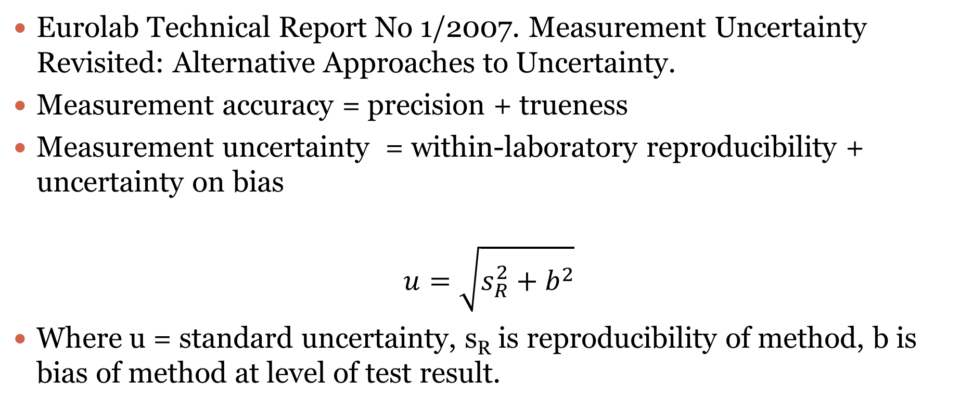
Single Within-Laboratory Validation
Eurolab Technical Report No 1/2007. Measurement Uncertainty Revisited: Alternative Approaches to Uncertainty.
Measurement accuracy = precision + trueness
Measurement uncertainty = within-laboratory reproducibility + uncertainty on bias
$$u=\sqrt{s_{R}^{2}+b^{2}}$$
Where u = standard uncertainty, s_{R} is reproducibility of method, b is bias of method at level of test result.

Slide 5
Precision Data
The within-laboratory standard deviation of reproducibility, s_{R}, determined from validation studies can be taken directly as a standard uncertainty
Use of single run repeatability data does not give true estimates of uncertainty
Reproducibility experiments should be designed to include as many within laboratory variables as possible
  Different runs, analysts, equipment, reagents, standards etc.

Slide 6
Levels
Precision may vary with the level of analyte
Separate estimates of uncertainty may be necessary at different levels
  Especially for low level measurements
Where relative precision is constant over the range of levels, a single relative uncertainty may be estimated
  Back-calculated for specific test results

Slide 7
Bias
The bias of a method, and its uncertainty, may be estimated from
Analysis of CRMs
Recovery experiments with fortified samples
Analysis of proficiency testing materials
Give priority to approach offering best traceability

Slide 8
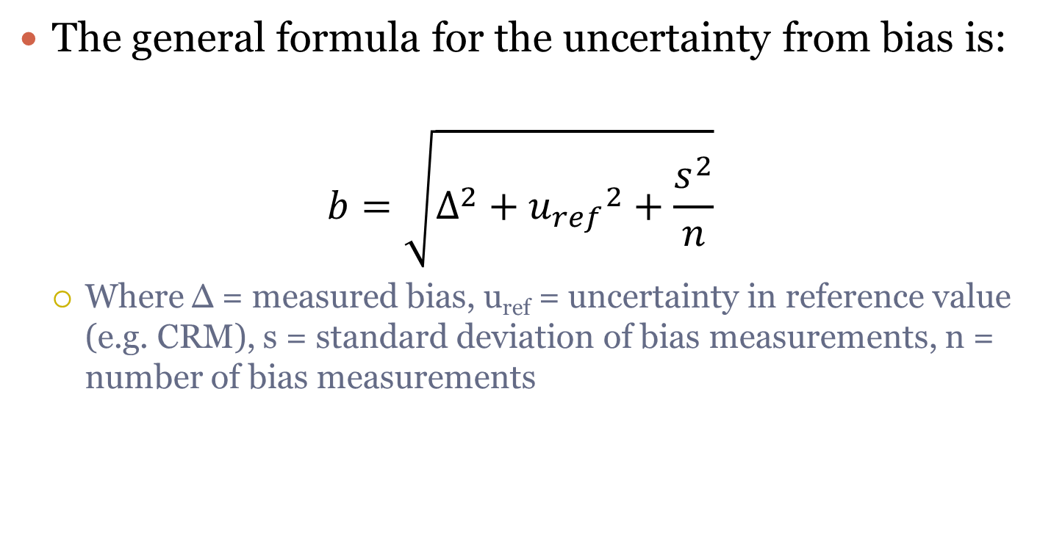
Bias
The general formula for the uncertainty from bias is:
$$b=\sqrt{∆^{2}+{u_{ref}}_{}^{2}+\frac{s^{2}}{n}}$$
  Where Δ = measured bias, u_{ref} = uncertainty in reference value (e.g. CRM), s = standard deviation of bias measurements, n = number of bias measurements

Slide 9
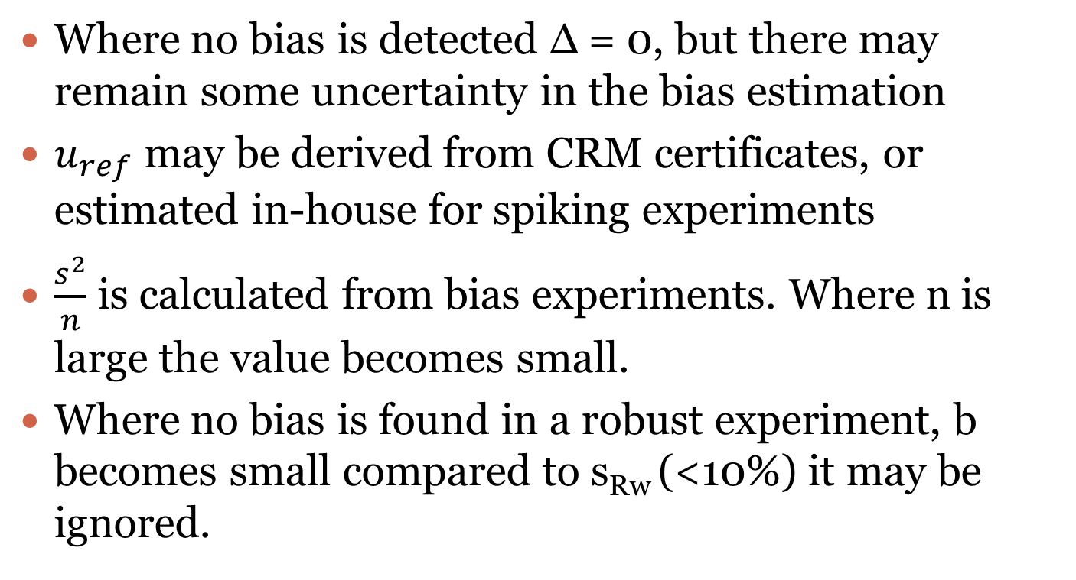
Bias Components
Where no bias is detected Δ = 0, but there may remain some uncertainty in the bias estimation
$u_{ref}$ may be derived from CRM certificates, or estimated in-house for spiking experiments
$\frac{s^{2}}{n}$ is calculated from bias experiments. Where n is large the value becomes small.
Where no bias is found in a robust experiment, b becomes small compared to s_{Rw} (<10%) it may be ignored.

Slide 10
Correcting for Bias
It is assumed that where bias is detected either:
  Method improvement is undertaken to reduce the bias, and/or
  A robust correction is applied to compensate for a small and well characterised residual bias
The above approach is applicable where there is a small residual bias after correction, if needed.
There is no well agreed approach to the uncertainty in a large uncorrected bias

Slide 11
Example
Ochratoxin in Wine by HPLC
  Solvent extraction, column clean-up, quantification by comparison of peak heights using fluorescence detection.
Precision study
  Two samples over a period of months using different analysts and equipment
Bias study
  Recovery experiments under same conditions
Other sources
  Above studies include all sources except purity of standard

Slide 12
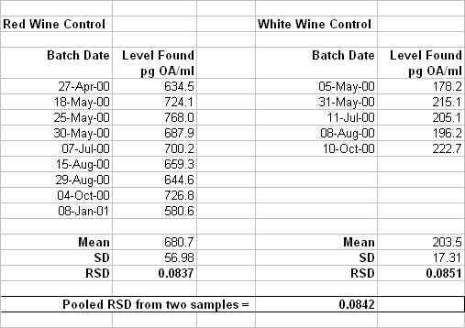
Reproducibility

Slide 13
Uncertainty from Reproducibility
The relative standard deviations from the two materials are similar (F test) so can be pooled together to give a reproducibility figure that applies across the range
s_{R} = 0.0842

Slide 14
Bias

Slide 15
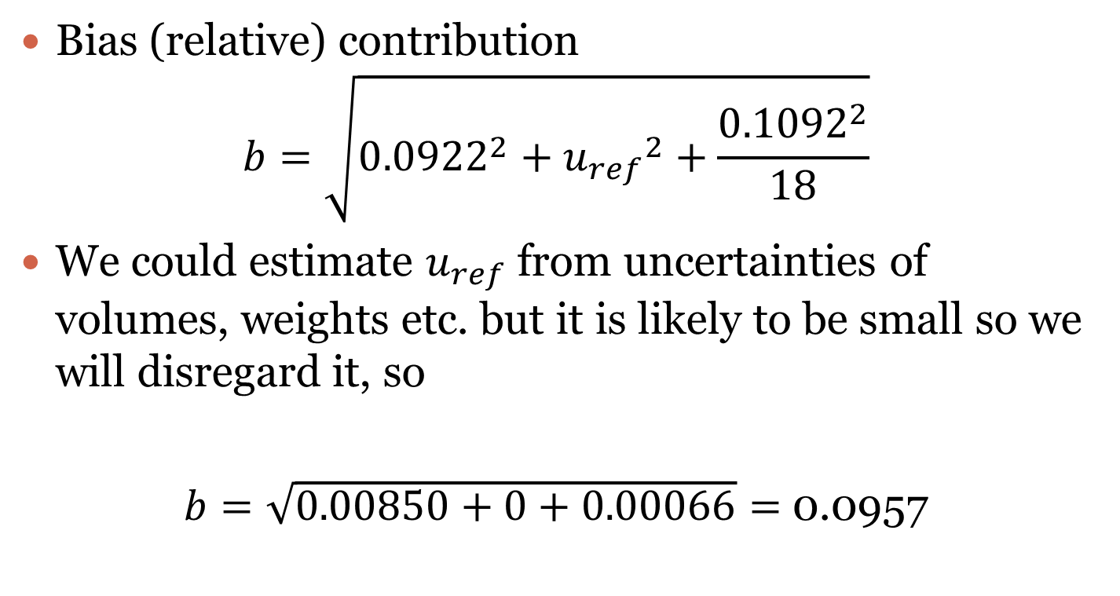
Contribution from Bias
Bias (relative) contribution
$$b=\sqrt{{0.0922}^{2}+{u_{ref}}_{}^{2}+\frac{{0.1092}^{2}}{18}}$$
We could estimate $u_{ref}$ from uncertainties of volumes, weights etc. but it is likely to be small so we will disregard it, so
$b=\sqrt{0.00850+0+0.00066}=$0.0957

Slide 16
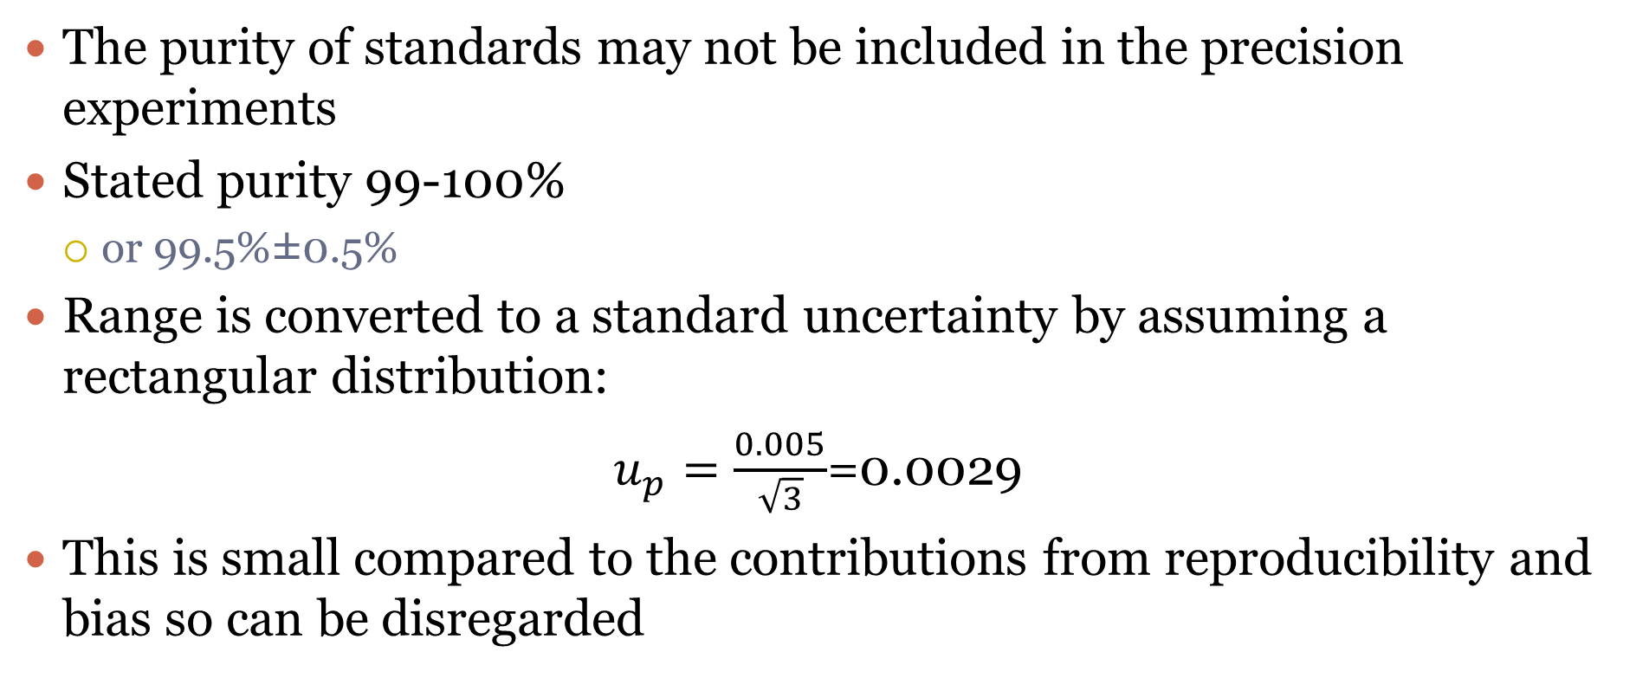
Purity of Standard
The purity of standards may not be included in the precision experiments
Stated purity 99-100%
  or 99.5%±0.5%
Range is converted to a standard uncertainty by assuming a rectangular distribution:
$u_{p}=\frac{0.005}{\sqrt{3}}$=0.0029
This is small compared to the contributions from reproducibility and bias so can be disregarded

Slide 17
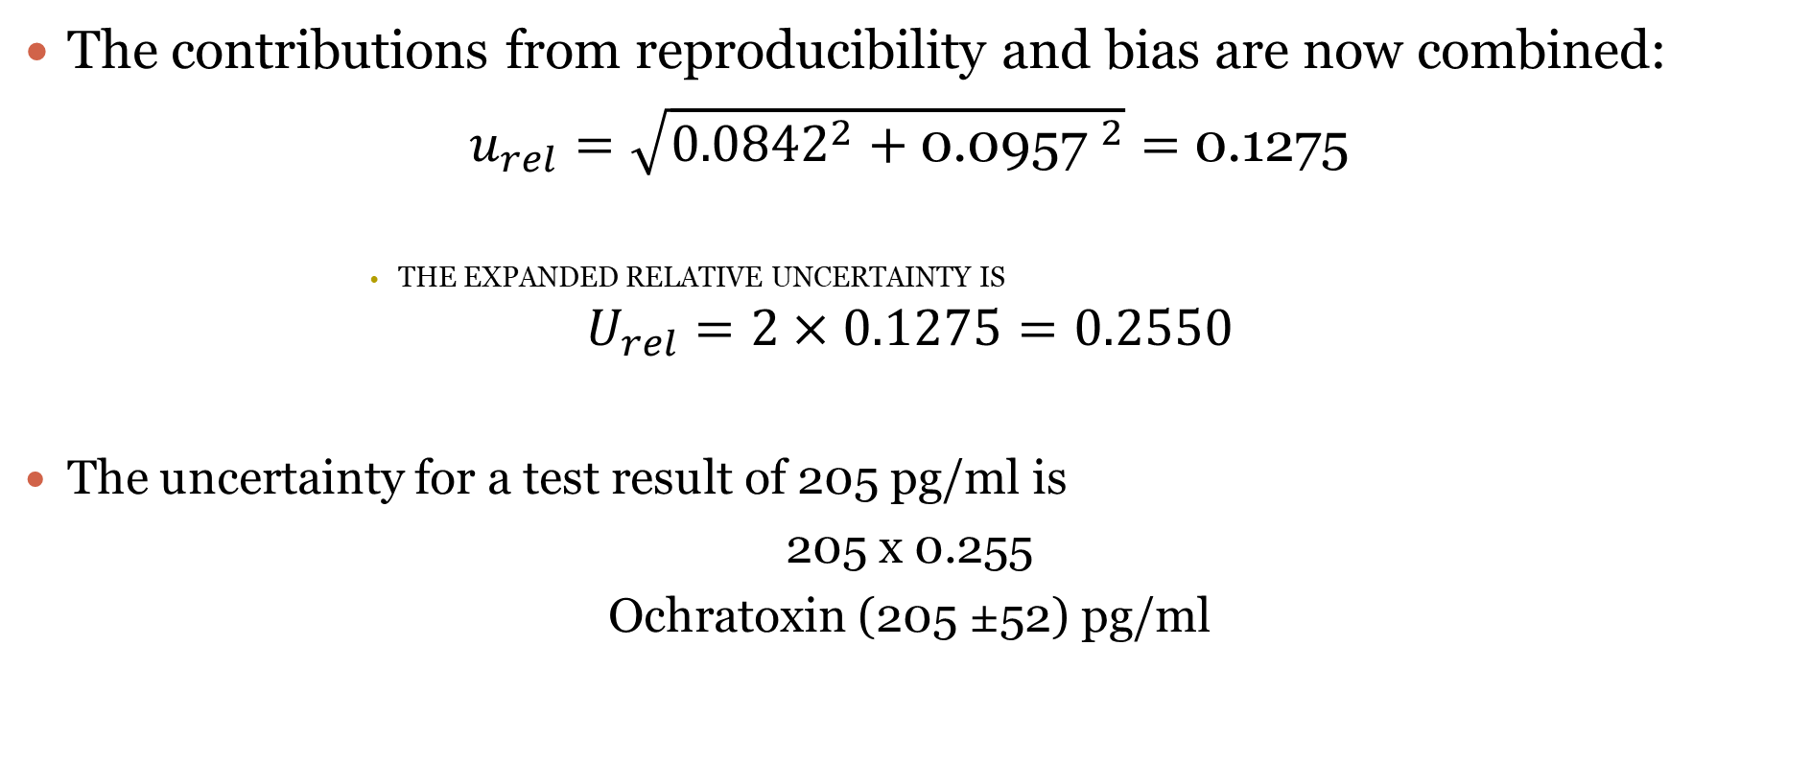
Combining Uncertainties
The contributions from reproducibility and bias are now combined:
$u_{rel}=\sqrt{{0.0842}^{2}+{\text{0.0957 }}^{2}}=$ 0.1275
                The expanded relative uncertainty is
$$U_{rel}=2×0.1275=0.2550$$
The uncertainty for a test result of 205 pg/ml is
205 x 0.255
Ochratoxin (205 ±52) pg/ml

Slide 18
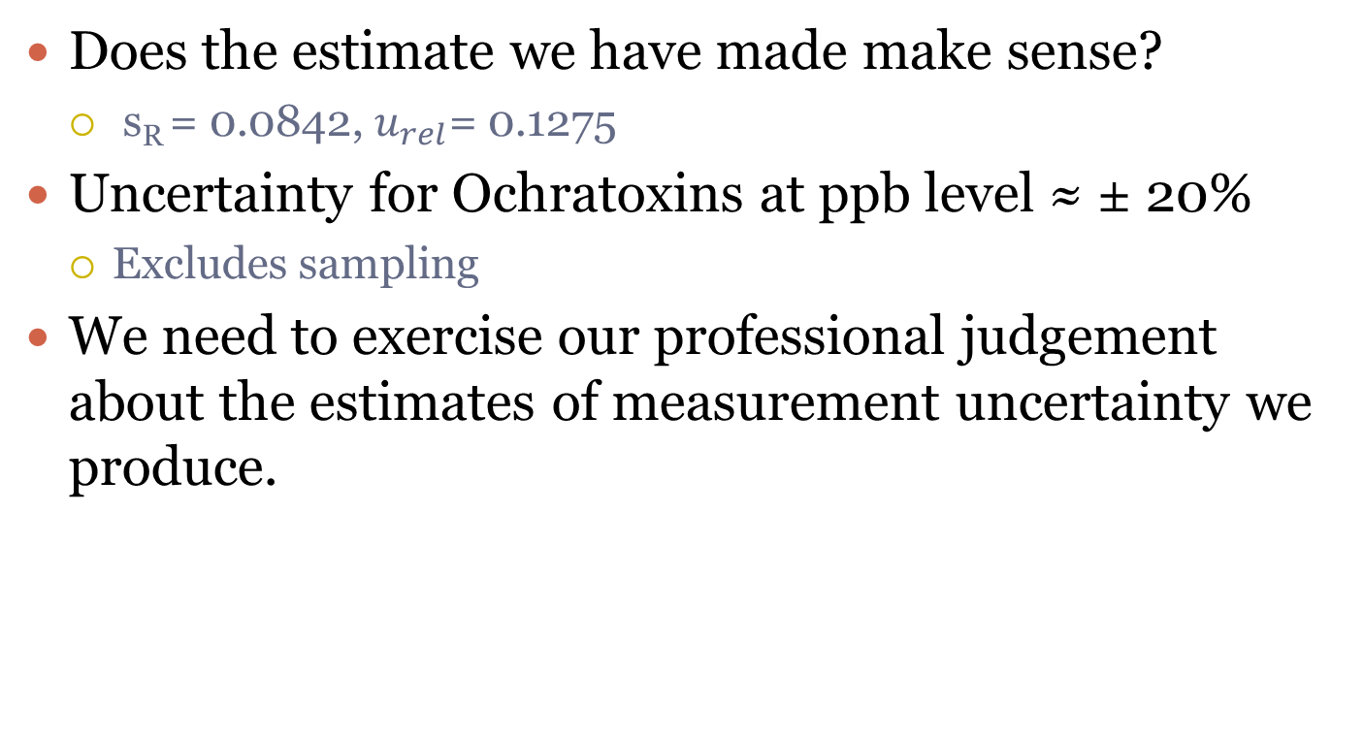
Common Sense Check
Does the estimate we have made make sense?
  s_{R} = 0.0842, $u_{rel}$= 0.1275
Uncertainty for Ochratoxins at ppb level ≈ ± 20%
  Excludes sampling
We need to exercise our professional judgement about the estimates of measurement uncertainty we produce.

Slide 19
Measurement Uncertainty
General Approach
Single Within-Laboratory Validation Approach
Precision Data
Uncertainty at Different Levels
Bias Data
  CRMs, Recoveries, Proficiency Testing
Example – Ochratoxin in Wine
Other Sources
Common Sense Check

