Slide 1
ISO 11352:2012 Water Quality
Estimation of
measurement uncertainty based on
validation and quality control data

Slide 2
Contents
EU REGULATIONS 2017
ISO 11352:2012
Estimation of Random & Systematic Errors
Use of Results from PT Comparisons
Examples – Annex A & B

Slide 3
EU REGULATIONS 2017
European Union (Drinking Water) (Amendment) Regulations 2017 (SI 464 2017)
Changed the way the suitability of test methods for water quality must be evaluated e.g.:
Accredited laboratories will have to demonstrate that they have verified their methods in the revised terms within the deadline to continue meeting the requirements of ISO 17025
Parameter | Trueness | Precision | LOD | Uncertainty
Until 31st December 2019
Copper | 10% PV | 10% PV | 10% PV
After 31st December 2019
Copper |  |  | 30% PV | 25% PV

Slide 4
ISO 11352:2012
Water quality — Estimation of measurement uncertainty based on validation and quality control data
This International Standard specifies methods for the estimation of measurement uncertainty of chemical and physicochemical methods in single laboratories based on validation data and analytical quality control results obtained within the field of water analysis.

Slide 5

Estimation of Random & Systematic Errors
Uses the simple model for estimating combined standard uncertainty:
$$u_{c}=\sqrt{u_{Rw}^{2}+u_{b}^{2}}$$
Random (Precision) | Systematic (Bias)
Stable control material covering whole of analytical process | Suitable reference materials (matrix, concentration)
Stable synthetic control sample | At least 6 samples analysed in PT schemes
 | Recovery from at least 6 different samples

Slide 6
Use of Results from PT Comparisons
Results from interlaboratory comparisons may be used in the same way as results from analyses of reference materials, if it is assumed that the assigned value in the interlaboratory comparison is a sufficiently good estimate of the true value.
NOTE 1 In proficiency testing schemes, often, only single measurements are performed on a single day. Therefore, the difference between a laboratory result and the assigned value is calculated for different interlaboratory samples. This difference then includes contributions from both the uncertainty component associated with method and laboratory bias, u_{b}, and the uncertainty component for the within-laboratory reproducibility, u_{Rw} . The contributions from both components can lead to an overestimate of measurement uncertainty

Slide 7
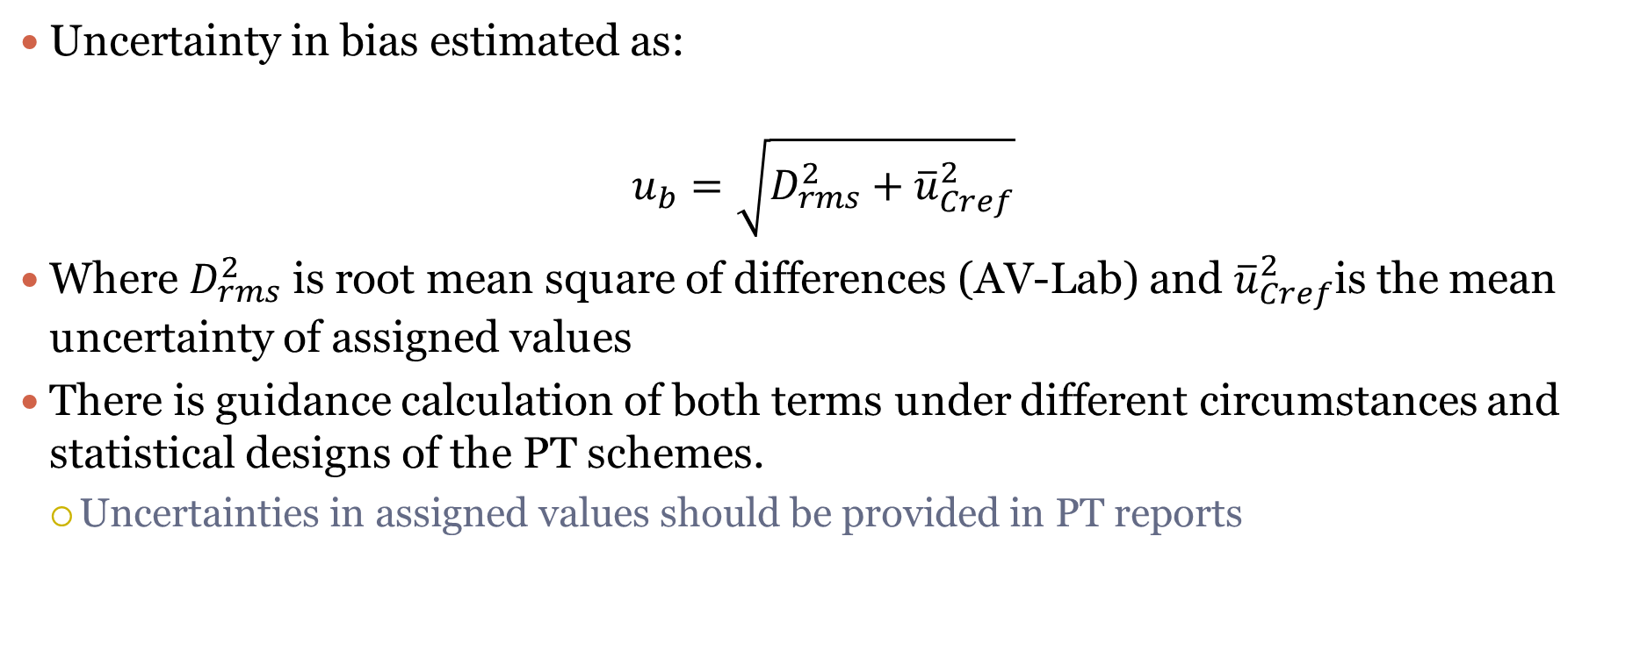
Estimation of Uncertainty in Bias
Uncertainty in bias estimated as:
$$u_{b}=\sqrt{D_{rms}^{2}+{\overline{u}}_{Cref}^{2}}$$
Where $D_{rms}^{2}$ is root mean square of differences (AV-Lab) and ${\overline{u}}_{Cref}^{2}$is the mean uncertainty of assigned values
There is guidance calculation of both terms under different circumstances and statistical designs of the PT schemes.
  Uncertainties in assigned values should be provided in PT reports

Slide 8
Examples – Annex A & B
Estimation of standard uncertainty from range control charts
Estimation of measurement uncertainty using reference material
  Uncertainty in reference materials
Estimation of measurement uncertainty based on data from proficiency tests
  Uncertainty in PT assigned values
Estimation of measurement uncertainty using a standard solution as quality control sample and recovery experiments
  uncertainty in the concentration of the analyte added

Slide 9
Contents
EU REGULATIONS 2017
ISO 11352:2012
Estimation of Random & Systematic Errors
Use of Results from PT Comparisons
Examples – Annex A & B

