Slide 1
Reference Materials
Definitions:- Reference material (RM)
“Material, sufficiently homogeneous and stable with respect to one or more specified properties', which has been established to be fit for its intended use in a measurement process.”

Slide 2
RM
RM is a generic term.
Properties can be quantitative or qualitative, e.g. identity of substances or species.
Uses may include the calibration of a measurement system, assessment of a measurement procedure, assigning values to other materials, and quality control.
An RM can only be used for a single purpose in a given measurement.

Slide 3










Slide 4
CRM Definition
Certified reference material (RM)
Reference materials, characterized by a metrologicaly valid procedure for one or more specified properties, accompanied by a certificate that provides the value of the specified property, its associated uncertainty, and a statement of metrological traceability

Slide 5
ISO Guide 34:2009 to ISO 17034:2016
Reference Material Manufacturing Process
Planning - Sampling - Feasibility Studies - Processing - Characterization - Value Assignment - Certification - Storage - Distribution - Post Distribution Process

Slide 6
Characterizations & intended use of the RMs
ISO 17034 - 7.12 Characterization
 | Group of expert laboratories | 1 expert lab & confirmation by 2 or more expert labs | Formulation | Interlaboratory comparison study
Property value | Derived as consensus value | One value | Value calculated from calibrant & confirmed from 1 or more labs. | Derived as consensus value
Type of Reference Material | Certified Reference Material | Certified Reference Material | Certified Reference Material | Quality Control Material
 | Quality Control Material | Quality Control Material | Quality Control Material
Intended use | All Quality Assurance aspects | All Quality Assurance aspects | All Quality Assurance aspects | For precision & for control charts

Slide 7
Metrological traceability
TRACEABILITY: property of the result of a measurement or the value of a standard whereby it can be related to the stated reference, usually national or international standard, throughout an unbroken chain of calibrations all contributing to measurement uncertainty. VIM 3

Slide 8
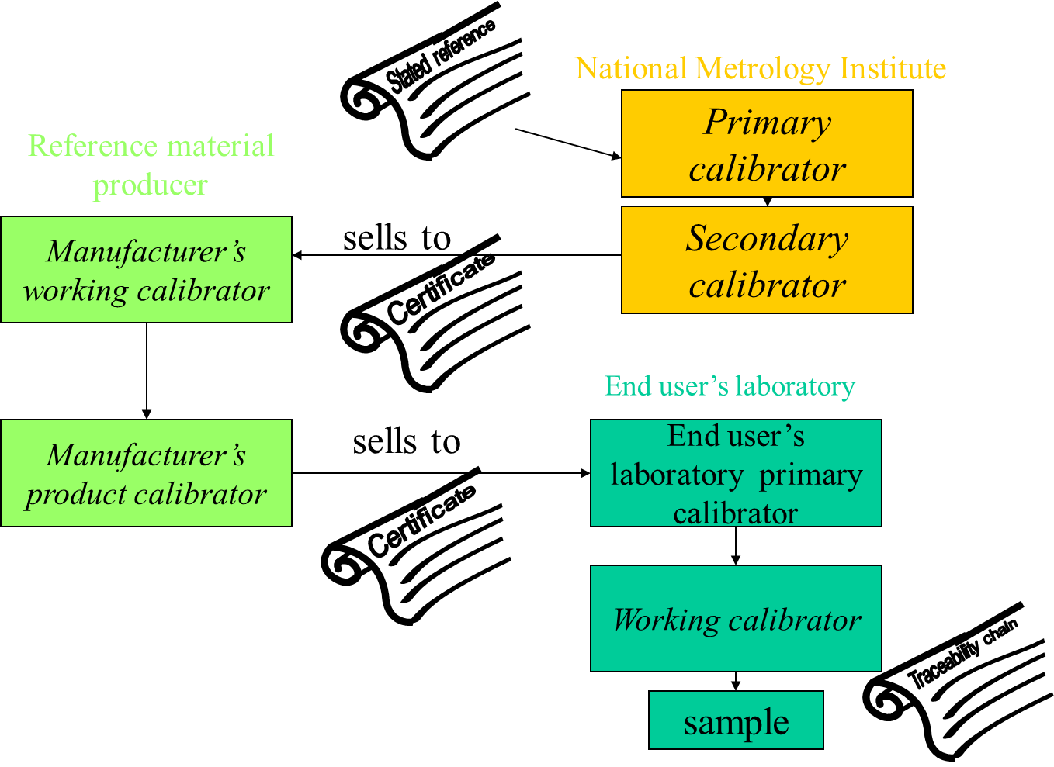

Slide 10
Food Matrix
“The food matrix organizational scheme can be used to select one or two food matrices representing each sector, for development of a series of reference materials representing all foods. In some sectors, several samples may be necessary to account for differences in all the types of protein, fat, or carbohydrate.”
W. R. Wolf and K. W. Andrews, “A System for Defining Reference Materials Applicable to All Food Matrices”, Fresenius’ J. Anal. Chem., 353:73-76 (1995)

Slide 11
Traceability
What is involved in the calibration of a “black box” type instrument
PCR testing Chemistry: (End point PCR) – one assessor described this as a Grey Area
- GMO (Plants)
- Meat Species e.g.
“1% Pork in Beef” or “5% Horse in Beef”

Slide 12
Traceability with regard to PCR
Process includes
Volume (pipetting into) – Wells – plate – PCR
Temperature (Temp difference)
Traceability of measurement
(these are critical measurements)

Slide 13
Traceability of Measurements
Traceability is required for both Temp & Volumetric critical measuring equipment
In UK there are 3 UKAS accredited calibration temp labs (ISO 17025) for PCR (e.g. Anachem)

Slide 14
Traceability of Measurements
(PT’s are readily available in this area)
Certified Reference Materials for Meat species there are available at different %’s CRM’s
CRM used as calibrant (IRMM) European Commission, Joint Research Centre, Institute for Reference Materials and Measurements
- if accredited to ISO 17034 :2016 (Nov) (Traceability assured)

Slide 15
Traceability with Automated PCR
PCR – DNA
Automated DNA purification, quantification, PCR and sequencing set up using the HamiltonStar and Starlet instruments
Robotic Well automated platform for the processing of samples
Extraction using automated system and the DNA investigator kit

Slide 16
Key measurements-Automated PCR
Traceability of the Volumetric / Temperature Apparatus could be equally considered a critical measurement.
- Liquid handler stations use low volumes of 1µl
- range 1 -1000µl
- Calibration certs for volume (balance) and temp

Slide 17
Automated PCR
a) calibration demonstrable for all liquid handlers used in this 1 – 10 µl range. (Hamilton customised a method in order to test the 1μl volume verification)
The manufacture wrote a script to enable the calibration carry out the on-site calibration.
b) Calibration certificates for both temperature (Tecan/Hamilton/Qiagen) and balance (Tecan/Hamilton) was carried out so traceability to SI standards was demonstrable.

Slide 18
Automated PCR
c) The Hamilton Heater Shakers are verified
On-site calibration carried out by an INAB Calibration laboratory, traceability of balances used was completed.

Slide 19
Traceability in Microbiological tests
In microbiological enumeration tests, uncertainty contributions of calibration will affect a number of items of equipment that may be used e.g.
the calibration of balances, autoclaves, incubator temperature probes, pipettes etc.
It is difficult to assess the actual affect as there are many factors involved; uncertainty contributions may be small but they are also likely to be cumulative.

Slide 20
The example of the incubator temperature
Critical one would be the 44C incubation step for Detection of E.coli where a significant increase or decrease in temperature could adversely affect the result of the test
too low, media not selective;
too high, E.coli unable to grow.

Slide 21
INAB No 5 Traceability Policy Statement
“It is emphasised that calibration certificates issued by equipment manufacturers or agents are not acceptable evidence of external traceability, unless these are clearly identified as having been issued by an acceptably accredited calibration laboratory”.

Slide 22
AB’s - ILAC Policy - Traceability
ILAC – P10 (01:2013) “ILAC Policy on the traceability of Measurement Results”
This document describes the ILAC policy with regard to the metrological traceability requirements,
Implementation date was Jan 2014
Applicable for ISO/IEC 17025 and ISO 15189

Slide 23
ILAC – P10
This policy may also be applied to other conformity assessment activities where testing and/or calibration is involved
(e.g., inspection and product certification).

Slide 24
Testing Labs - ISO 17025
General requirements for traceability
ISO 17025:2005 Section 5.6.1
All equipment used for tests and/or calibrations, including equipment for subsidiary measurements (e.g. for environmental conditions) having a significant effect on the accuracy or validity of the result of the test, calibration or sampling shall be calibrated before being put into service.

Slide 25
Testing Labs - ISO 17025
For reference standards the traceability requirements of ISO/IEC 17025:2005 are:
5.6.3.1 “The laboratory shall have a programme and procedure for the calibration of its reference standards. Reference standards shall be calibrated by a body that can provide traceability as described in 5.6.2.1. Such reference standards of measurement held by the laboratory shall be used for calibration only and for no other purpose, unless it can be shown that their performance as reference standards would not be invalidated. Reference standards shall be calibrated before and after any adjustment.”

Slide 26
ILAC P10 Policy
For equipment and reference standards that require calibration, the ILAC P10 policy is that they shall be calibrated by:

Slide 27
ILAC P10 Policy
1) An (NMI) National Metrology Institution whose service is suitable for the intended need and is covered by the CIPM MRA.
or
2) An accredited calibration laboratory whose service is suitable for the intended need (i.e, the scope of accreditation specifically covers the appropriate calibration) and the accreditation Body is covered by the ILAC Arrangement or by Regional Arrangements recognised by ILAC.
or

Slide 28
ILAC P10 Policy
3a) An NMI whose service is suitable for the intended need but not covered by the CIPM MRA. In this case the accreditation body shall establish a policy to ensure that those services meet the relevant criteria for metrological traceability in ISO/IEC 7025:2005.

Slide 29
ILAC P10 Policy
  3b) A calibration laboratory whose service is suitable for the intended need but not covered by the ILAC Arrangement or by Regional Arrangements recognised by ILAC. In these cases the accreditation body shall establish a policy to ensure that those services meet the relevant criteria for metrological traceability in ISO/IEC 17025:2005.

Slide 30
ISO/IEC 17025
Clause 5.6.2.1.2 of ISO/IEC 17025:2005, states
“certain calibrations that currently cannot be strictly made in SI units”
“traceability to appropriate measurement standards such as”:
- the use of certified reference materials provided by a competent supplier to give a reliable physical or chemical characterization of a material; (e.g. ISO 17034)
- the use of specified methods and/or consensus standards that are clearly described and agreed by all parties concerned.
Participation in a suitable programme of inter laboratory comparisons

Slide 31
ILAC P10 Policy
The ILAC P10 policy is:
5) If the calibration of instruments used in testing contributes significantly to the overall uncertainty, the same policy for traceability applies (as detailed under 1) to 4) above).
6) If a calibration is not a dominant factor in the testing result, the laboratory shall have quantitative evidence to demonstrate that the associated contribution of a calibration contributes little (insignificantly) to the measurement result and the measurement uncertainty of the test and therefore traceability does not need to be demonstrated.

Slide 32
ISO/IEC 17025
In ISO/IEC 17025:2005 the further requirement for traceability for testing laboratories is:
5.6.2.2.2 Where traceability of measurements to SI units is not possible and/or not relevant, the same requirements for traceability to, for example, certified reference materials, agreed methods and/or consensus standards, are required as for calibration laboratories (see 5.6.2.1.2).
In this case ILAC policy for traceability applies 4) of ILAC P10

Slide 33
ISO 15189
In ISO/IEC 15189:2012 5.3.1.4 Equipment calibration and metrological traceability:
………..The laboratory shall have a documented procedure for the calibration of equipment that directly or indirectly affects examination results……….
a) taking into account conditions of use and the manufacturer’s instructions;
b) recording the metrological traceability of the calibration standard and the traceable calibration of the item of equipment;
c) verifying the required measurement accuracy and the functioning of the measuring system at defined intervals;
Metrological traceability shall be to a reference material ……..

Slide 34
ISO/IEC 15189:2012 5.3.1.4
Where this is not possible or relevant, other means for providing confidence in the results shall be applied, including but not limited to the following:
- use of certified reference materials;
- examination or calibration by another procedure;
- mutual consent standards or methods which are clearly established, specified, characterized and
mutually agreed upon by all parties concerned.

Slide 35
ILAC P10 Policy
If the calibration of instruments used in testing contributes significantly to the overall uncertainty, the same policy as in Sections (1 to 4) of ILAC P10 document apply

Slide 36
INAB Policy
We will need to have consistency and be seen to apply the requirements of ILAC P10 to all testing labs

